Slide 1
Adaptive Leadership for Human Security - Georgian Context
Zaal Anjaparidze
2019

Slide 2
Which Picture Better Suits Adaptive Leadership?

Slide 3
What is Adaptive Leadership?
Style helping to adapt to constantly changing dynamics with diverse groups and stakeholders
Skills in intercultural competence, coordination, conflict assessment
Ability to adapt to religious, ethnic and other differences, negotiate and prevent conflicts
Abilities for strategic, operational, and tactical civil-military-police coordination in complex environments

Slide 4
Profile of Adaptive Leader
Accepts complex environments with unclear situation and uncertainty
Finds a way to understand the motivations and patterns of behavior in other stakeholders
Listens to many different points of view, learns and shares information proactively
Demonstrates courage and ability to make difficult and even risky decisions

Slide 5
Profile of Adaptive Leader
Communicates, coordinates, builds relations with all stakeholders
Finds areas for cooperation between different stakeholders and creates forums for them
Recognizes the need for improvisation, trial and error, continuous learning and evaluation
Listens and learns from others to help develop a common vision. Thinks outside the box.

Slide 6
Profile of Adaptive Leader
Responds based on his/her assessment of the context, not on the personal preferences, Sets the examples and models for others
Takes “smart” risks by calculating all “pros and cons” in unpredictable environments. how they would like others to act
Sticks to his/her principles and only makes compromises when it does not violate leader’s integrity
Always seeks for “Win-Win” solutions when stakeholders develop solutions addressing their main interests

Slide 7
Leadership in Complex Environment
Assess your own skills and personal qualities to determine whether you are the right person to intervene as an adaptive leader
Complex environments require leadership from both men and women. Women and men share leadership
UN Security Council Resolution 1325 and 2242 affirm the positive contributions women make to peace, security and conflict-prevention

Slide 8
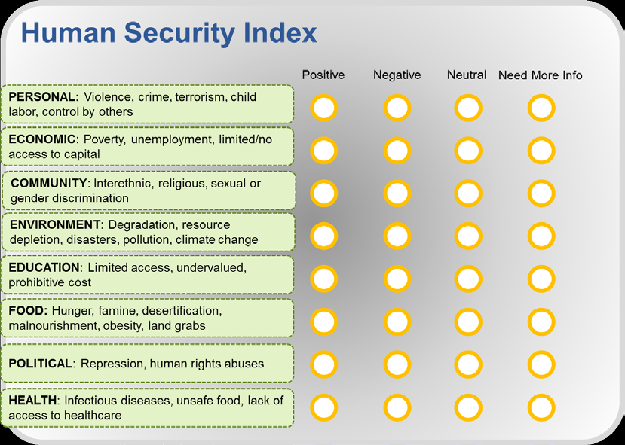
Adaptive Leadership and Human Security Index (http://www.humansecurityindex.org/

Slide 9
Thanks for your attention and participation
Visit ICCN at www.iccn.ge

