Slide 1
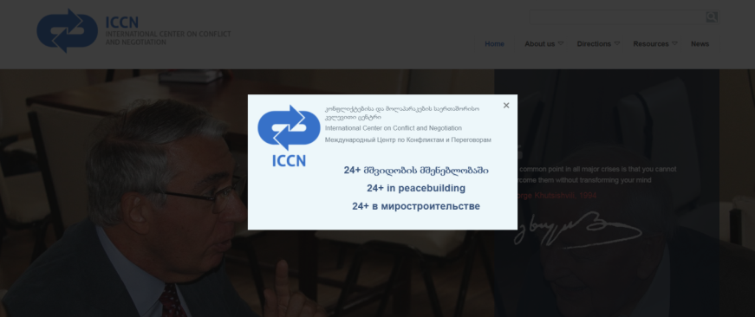
Women’s Engagement in
Peace Processes: case of Georgia
www.ICCN.ge
by Nina Tsikhistavi-Khutsishvili, Director
International Center on Conflict and Negotiation (ICCN)
19 September, 2019

Slide 2
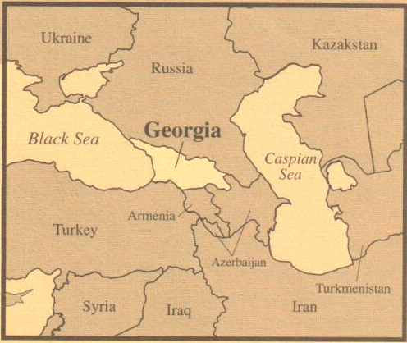
where Georgia is situated?
Source: The Culturgram of Georgia, 2000
www.iccn.ge

Slide 3
what is Georgia’s Peace Process:
Geneva International Discussions (GID) – out of 12th August 2008 Sarkozy Peace Plan signed by Saakashvili and Medvedev. About 50 rounds are held.
The Prague Format, e.g. the bilateral dialogue between the Deputy Foreign Minister of Russia with the Special Representative of the Prime Minister of Georgia for Relations with Russia, formed in 2012.
    The EUMM – the only post-conflict international monitoring mission – out of the subsequent implementing measures agreed on 8 September 2008. Subsequent to this decision 2 IPRMs were established that are holding meetings in Ergneti and Gali.

Slide 4
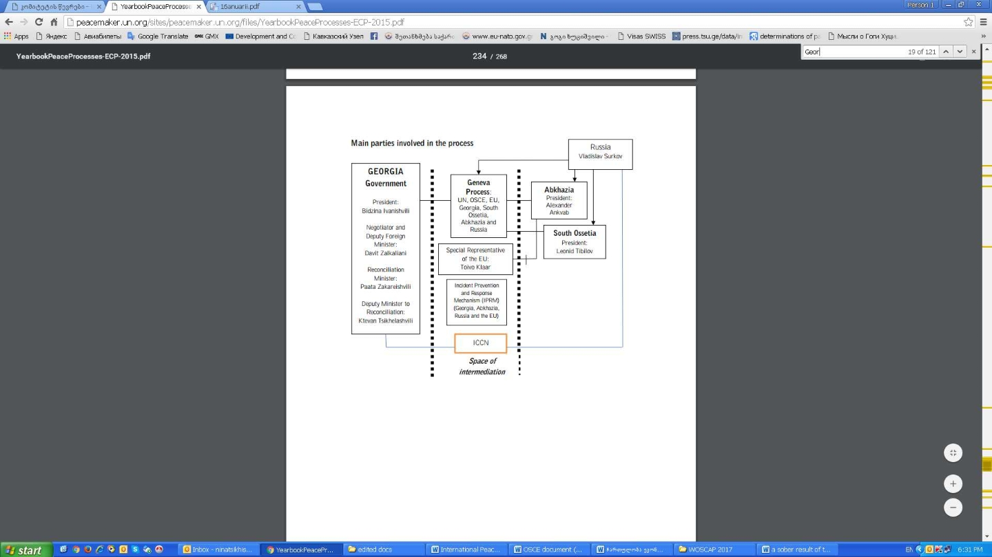
where the ICCN lays in the Peace Process of Georgia?
Source: The School of a Culture of Peace, Autonomous University of Barcelona (2015, 2016, 2017 & The UN Peacemaker

Slide 5
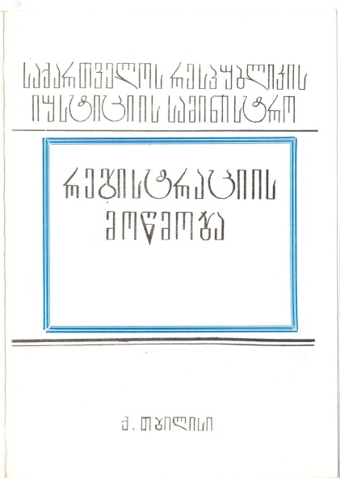
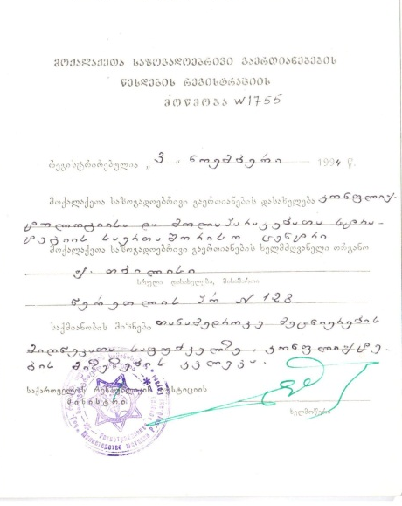
when ICCN was established
On 8th of August 1994, the International Center on Conflict and Negotiation was founded by 63 founding members. The organisation was registered by the Ministry of Justice of Georgia:
Decision #20/3, 1994 ; Registration # 1755
As a private law entity, non-for-profit, non-partisan organisation,
with a profile of professional conflict studies to research, educate, engage in negotiations and public diplomacy.

Slide 6
what is our mission www.ICCN.ge
The Mission of ICCN is to foster Peace Process through democratic reforms in Georgia, to strengthen civil society, achieve civil integration (focusing on minority and gender issues), and implement and support peacebuilding at grassroots, as well as middle and decision-making levels in order to ensure conflict prevention and transformation before during and after the conflict.

Slide 7
what is our vision www.ICCN.ge
The Vision of ICCN: Democratic reforms and conflict resolution by peaceful means in Georgia are developing in difficult environment, and territorial integrity of the country is impaired.
The state declares Peace Process, Reconciliation and Integration a high priority, but even these remain declaratory.
Civil society’s participation is underrepresented and a significant change for sustainable peace decelerated.
This situation requires mobilisation of the civil society to ensure establishment of liberal-democratic value system where conditions for a dialogue are created.
ICCN is actively involved in civil society’s efforts to influence public opinion, decision-making and its vision is that civil society will find enough strength and persistence to oppose the negative tendencies and ensure the path of democratic reforms.

Slide 8
how do we work www.ICCN.ge
what do we do:
  we create a space for a dialogue (GEO-RU,ARM,AZER, SOUTH Caucasus); - ways out of crisis, ways for compatibilities of two economic systems of the region: AA/DCFTA and EAEU,
  we provide stakeholders with a policy recommendations; (for governmental and intergovernmental organisations, SCs on national, regional and international levels): running dialogues, normalisation of relations between GE and RU, overcoming deadlock under the GID, strengthening of CS by the EU;
  we empower CS to become engaged and strengthened stakeholder in the field (networking partnership): Networking, partnership, common strategies to implement.
  ….
what is our method:
  remain impartial and transparent: getting zero financial assistance from any neighbouring or own governments, etc.;
  keep institutional memory: GeoPeace Database of Peace Agreements and dataproceeding;
  plan and evaluate: logframe analysis, theory of change, etc. – all tools that are adapted for peacebuilding.
  ….

Slide 9
2017 ICCN’s presented the
GEO Peace Agreements database
The presentation of the GEO PeaceDatabase of Georgia’s Violent Conflict Settlement Peace Agreements (PA)
was organised by ICCN on 29th of June, 2017 at Ivane Javakhishvili Tbilisi State University (TSU).
Participated by relevant stakeholders: representatives of CSOs, government and Dip. Corp., etc.

Slide 10
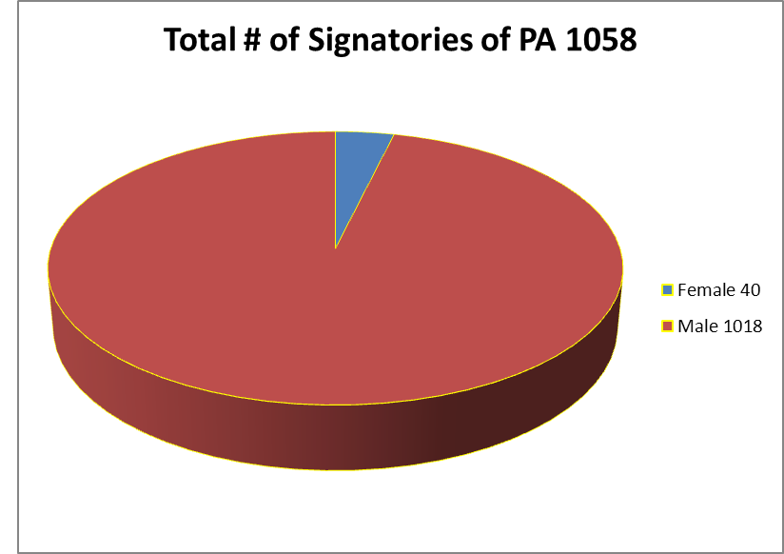
Gender Provision of PAs
4% women; 96% men (1991-2001)
Source: Tsikhistavi-Khutsishvili, N. (2017). The Presentation of the GEO PeaceDatabase, ICCN. June, 2017.

Slide 11
challenges in the context
The freedom of movement for inhabitants of seccesioned territories:
  how to divide political issues, from conflict resolution, basic HR so they are on place, exercised and applied (the issue of Political Recognition vs FoM/freedom of travel)?
  where to stand for CBM? do we have a legal space?
  CS’s underrepresentation in building the sustainable peace out of peace processes:
  to what extend national stakeholders (from CS) are excluded from Track 1 negotiations?
  Are we invisible when it comes to equal participation? Peace Process consists of 3 integral pillars – Government Officials’ initiatives, Third Neutral Parties/Diplomats involvement, Peace practitioners’ actions (e.g. CBM).
  Can we compare peace practitioners and human rights defenders in terms of their recognition and protection? The legal recognition and protection of human rights defenders (HR defenders) and UN Declaration on Human Rights Defenders of 1998; protection systems on national and international levels; Nothing stands for peacebuilders/peace practitioners;
  court representation, etc.).

Slide 12
challenges in the context (2)
  Women Peace and Security (WPS) – the approach never protects peacebuilders themselves
  What is a security level of peace practitioners while working in the field of peacebuilding? (Chatham House Rule is usually applied during the CBMs or any dialogue process). In post-conflict realities the rule is extended and widened – there must be no lists of participants, no photos, no anything that identifies participants
The legitimation of our work: there is no definition, followed with no recognition:
  who is a Peacebuilder, peace activist, peace agent for change, peace antenna? Is it a profession (out of relevant subjects taught in universities), or a job (out of relevant positions), or maybe a role to play (out of personal responsibility)? The factual lack of legal basis is bringing a mistrust to the context on all levels: from national to international one.
  What are guidelines for a daily activities and projects for a peacebuilder?
  Despite the dozens of definitions and concepts developed to identify peacebuilding as an area and a field, there is no definition of a peacebuilder.
  Beyond hard work and solid planning, peaceuilders reﬂect on “how things work,” on “what they have learned from experience”,
  in fact peacebuilders are developing experience-based theory.
What do we do:
  in fact we are mediating between parties through creating /providing conditions for the dialogue and reaching the common solution for the issue. National legislations are recognizing a court mediation but never a peace mediation. How to influence the situation and bring a change?

Slide 13
The Network of Women mediators of South Caucasus
NWMSC is a network of professional women peacemakers representing different organizations committed to conflict transformation, conflict resolution, and peace building in the South Caucasus.
In 2016, the International Center on Conflict and Negotiation (ICCN) initiated the creation of the Network of Women Mediators of South Caucasus and invited partners and colleagues from the South Caucasus Networking Partnership. The program is implemented by ICCN as the Regional Secretariat of the Global Partnership for Prevention of Armed Conflict (GPPAC) in Caucasus. As a follow up the initiative was discussed during the Regional Steering Group (ISG) meeting in Istanbul in November 2017.
In an endeavor to enable South Caucasus women mediators and peace-builders to advance the inclusion and meaningful participation of women in all phases of peace processes and in order to contribute to achieving and sustaining peace

Slide 14
what is next
to achieve solidarity - how to show a spirit to a person next to us
to speak – so they can see /recognise us
to continue – mobilization of resources (and) to keep walking

Slide 15
thanks 4 attention
thank you for your participation and questions
ninatsikhistavi@iccn.ge
www.ICCN.ge

