Slide 1



DEVELOPING PARTNERSHIP
TO INITIATE &DEVELOP
CAUCASUS REGONAL PROCESSES
&
LINK IT TO A GLOBAL PROCESSES 4
CONFLICT PREVENTION AND PEACEBUILDING
International Center on Conflict and Negotiation (ICCN)
The History of
GPPAC ICCN South Caucasus Networking
3-5 November, 2017 Istanbul, Turkey

Slide 2
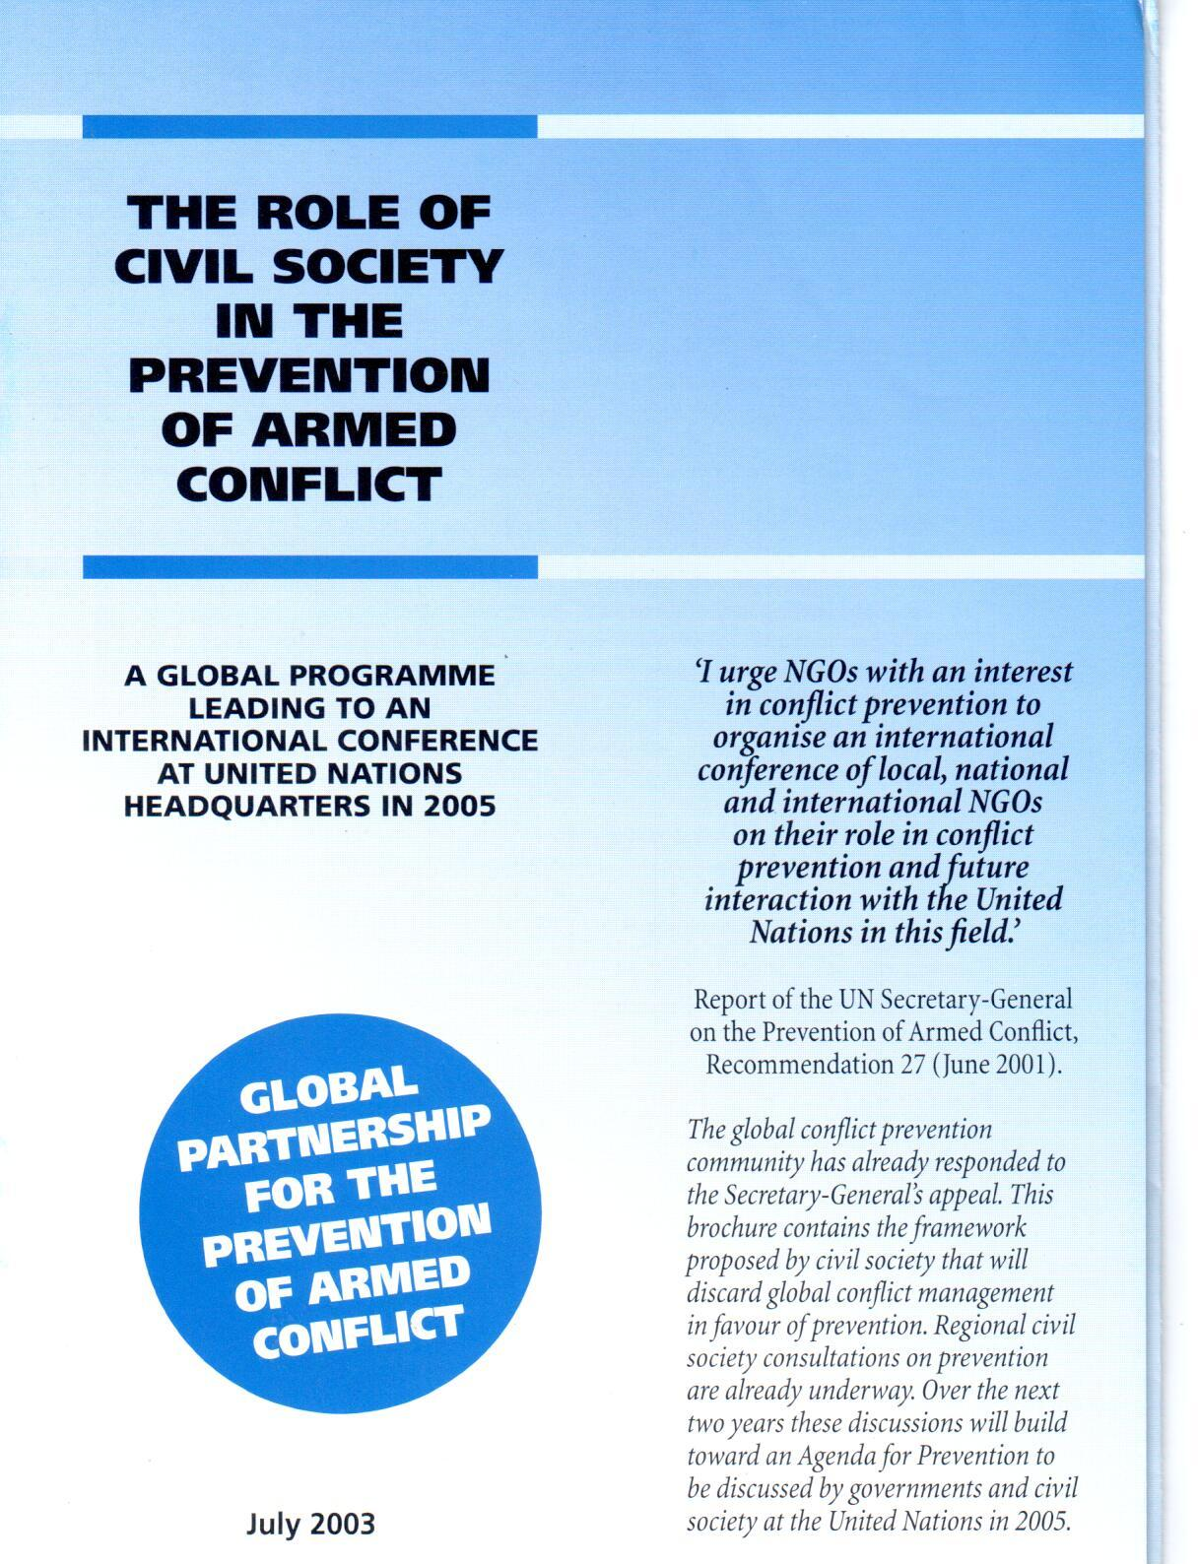
2000-2001 - ICCN-ECCP cooperation to set a conflict prevention, conflict management and peacebuilding profile CSOs database in the Caucasus.
2002 - An integrated global programme leading to an international conference at UN Headquarters in New York was proposed by ECCP;
(Kofi Annan supported the initiative and intensive consultations within the conflict prevention community began. Sixty delegates from all over the world met in the Dutch town of Soesterberg to plan the programme. The selected ISG – International Steering Group (ISG) and the ECCP as a secretariat was accepted).
2003\2004 - Under the programme of ECCP “The Role of Civil Society in the Prevention of Armed Conflict” ICCN has facilitated the Caucasus Regional Process. The First Regional Conference preparations started in 2003;

Slide 3
Networking landscape of CSO 2002-2003
Caucasus NGO Networks:
  Caucasus Forum (through International Alert),
  Cringo (through DRC), The Caucasus Refugee NGO Network (CRINGO);
  Caucasus Network of the CIS;
  NGO Working Group on Conflict Management and Prevention;
  EWEC – Early Warning of Ethnic Conflict Network (Through ICCN)
  the Regional Rub-Network of the CIS NGO Working Group on Conflict engagement and Prevention;
  FEWER Forum on Early Warning and Early Response – CIS conflict prevention network (Through Institute of Ethnology, lead by V.Tishkov, RF);
  Strengthen of NGOs and NGO Networks in the field of Conflict Prevention in region:
  to strengthen and develop the Caucasus networking for Social research and conflict resolution;
  to develop Regional Platform on Effective Action;
  to help in shaping the Caucasian Regional Process with participation of NGOs, regional networks, representatives of international organisations, regional authorities.

Slide 4
2004 - Preparing the 2005 International Conference at the UN Headquarters:
- Regional Conference of CSOs, February 25-27, 2004, Likani, Georgia;
- EU and the South Caucasus: opportunities for intensified engagement – ECCP, The Hague, Netherlands, May 24-26, 2004;

Slide 5
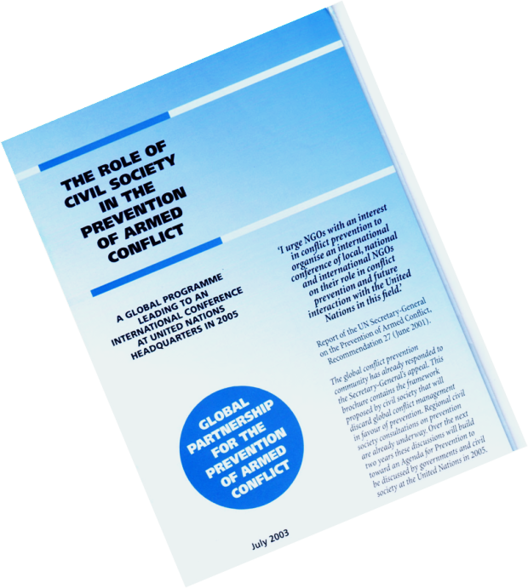
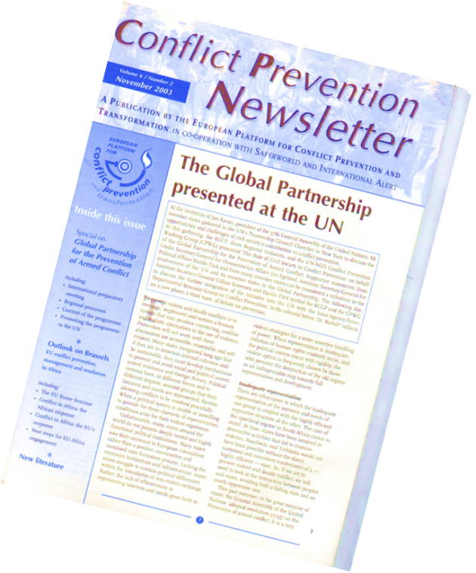
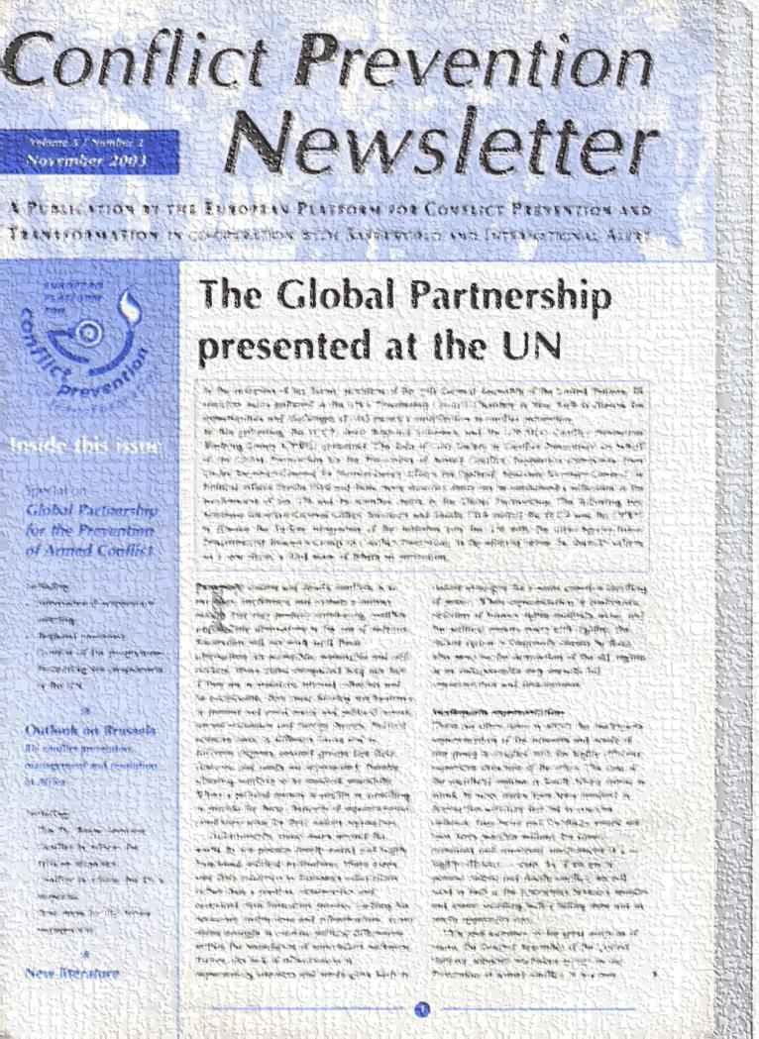
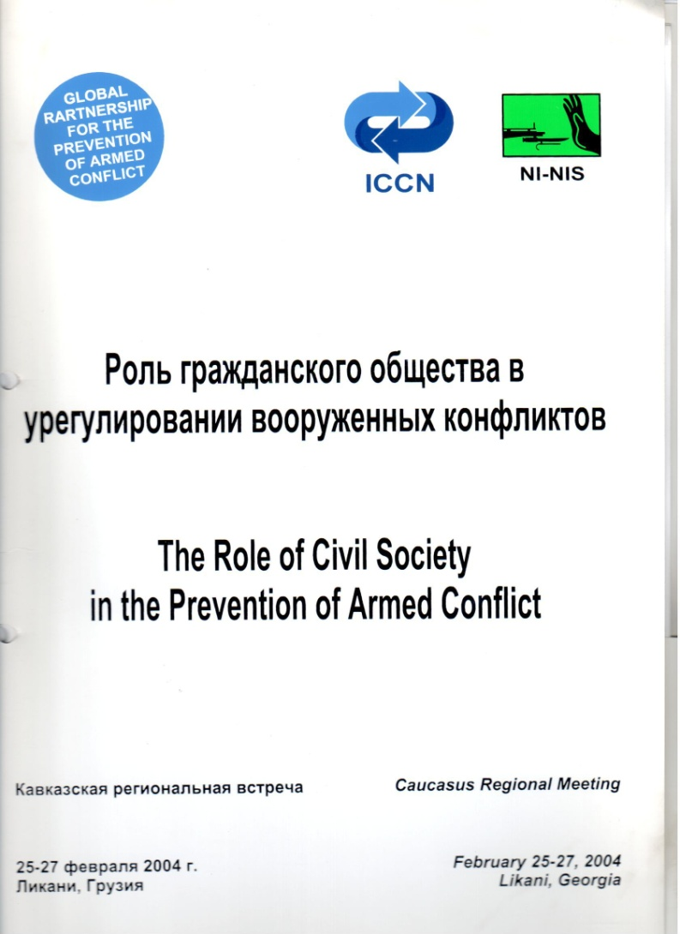
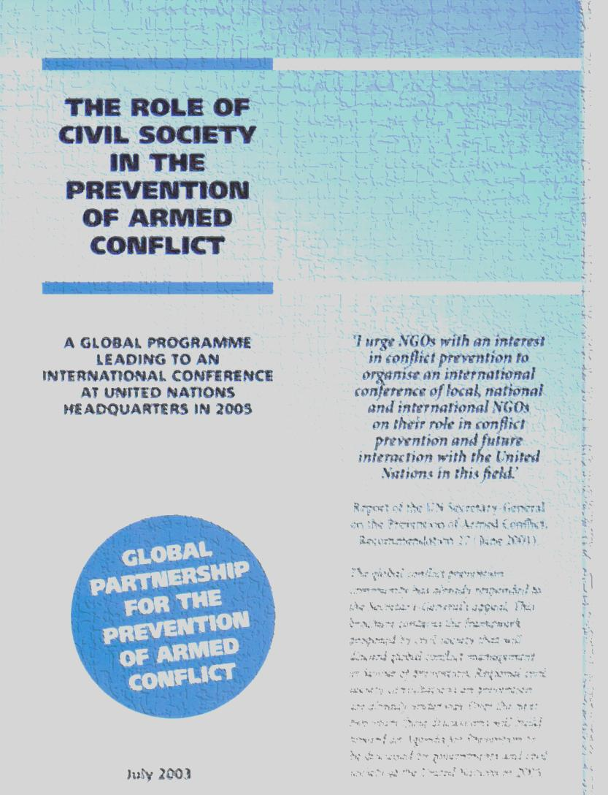
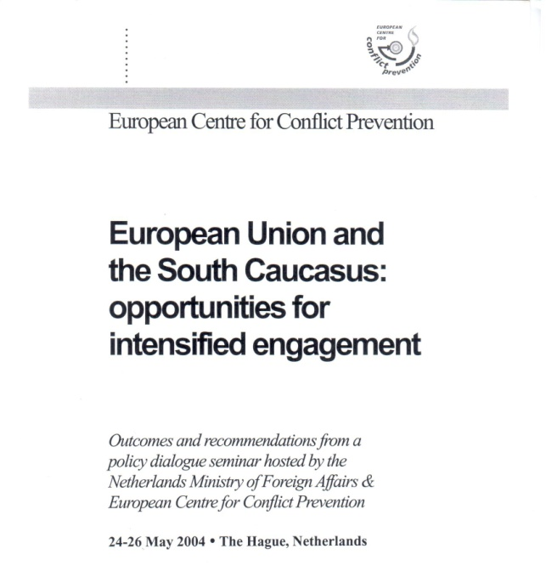

Slide 6
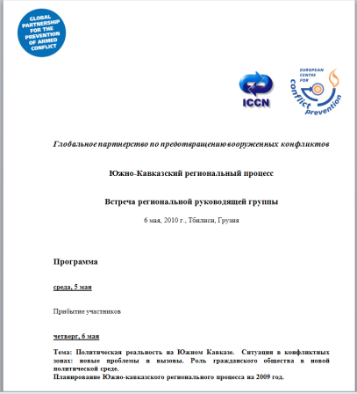
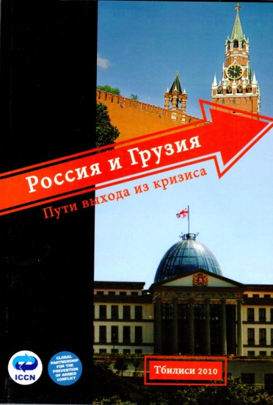
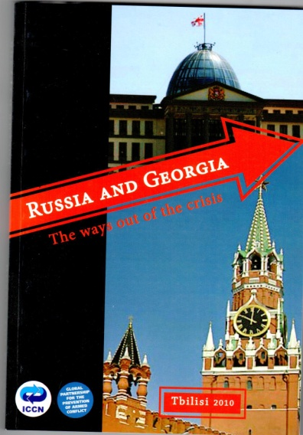
2005 - ICCN the Regional initiator in partnership with The European Centre for Conflict Prevention (ECCP);
A regional “Action Agenda” and “Action Plan” presented at the Conference at the UN headquarters, March 24-25, 2005, Tbilisi, Georgia
2006 – RSG Meeting, May, 2006, Tbilisi, Georgia
2007 – RSG Meeting, June, 2007, Tbilisi, Georgia
2008 - Geo-Russian Dialogue – expert meeting to find ways out of the crisis, The Istanbul Process was initiated; November, Istanbul, Turkey;
2009 – Istanbul Process – Track 2 of the Dialogue between experts from Georgia and Russia, October, Istanbul, Turkey
2009 – Peace Journalism, South Caucasian Meeting, 21 September, Tbilisi, Georgia
2010 - RSG Meeting – 6th of May, 2010, Tbilisi, Georgia;
2010 - Workshop on “The Role of Media in Conflict Prevention Peacemaking (Stage II)” on 15-16 July 2010, Tbilisi, Georgia
2010 – Istanbul Process, Geo-Ru Dialogue, 15 November, 2010, Istanbul, Turkey
2010 - Second meeting of young political leaders from Armenia and Azerbaijan in Tbilisi, 18-19 December 2010, Tbilisi, Georgia

Slide 7
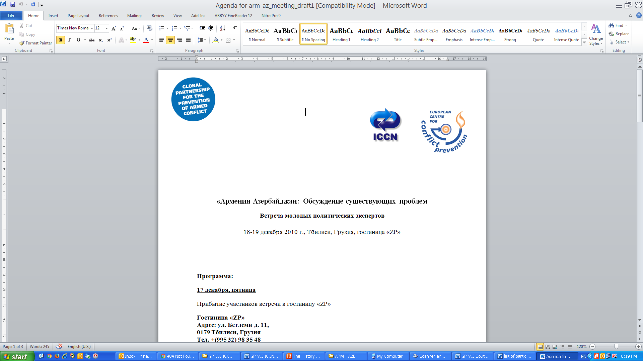
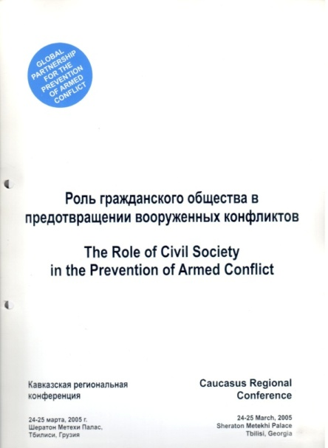
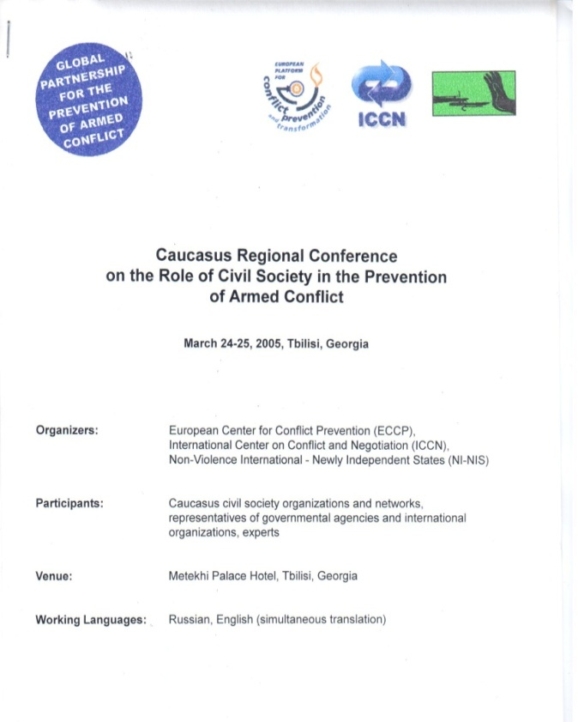
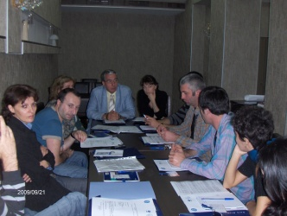
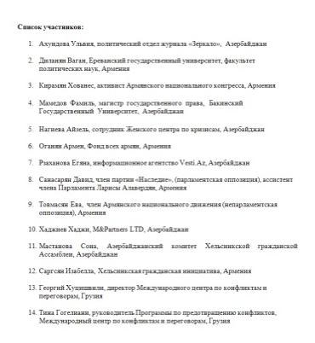
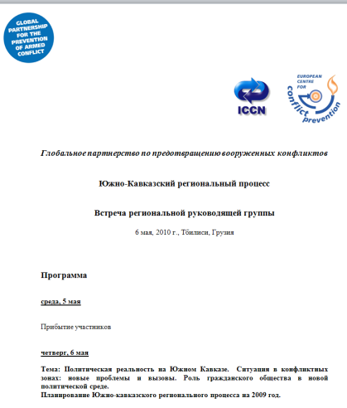
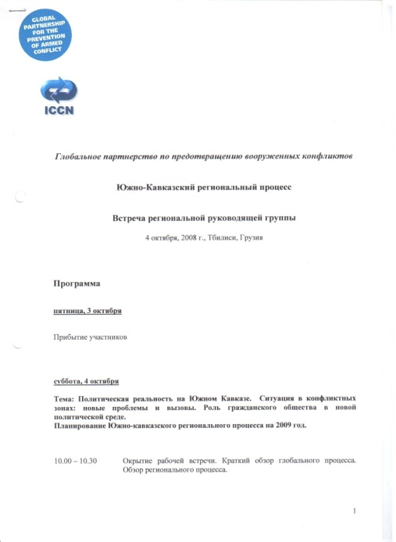
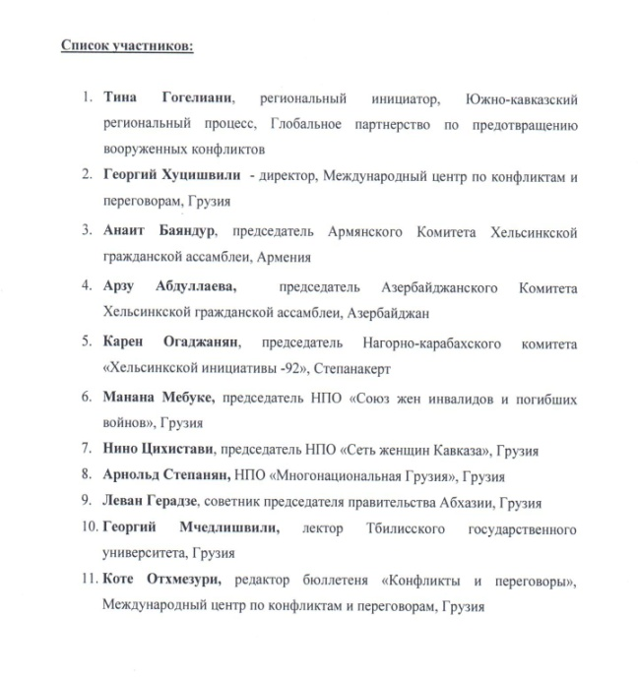
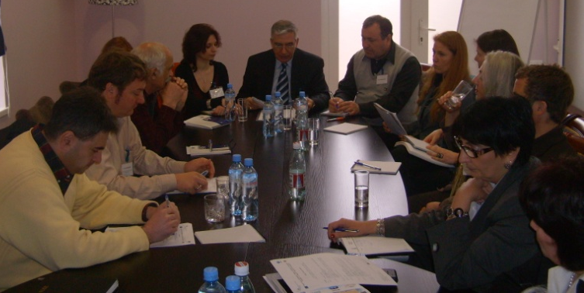
GPPAC ICCN 21.09.2009, Tbilisi, Georgia
GPPAC ICCN 4.10.2010, Tbilisi, Georgia

Slide 8

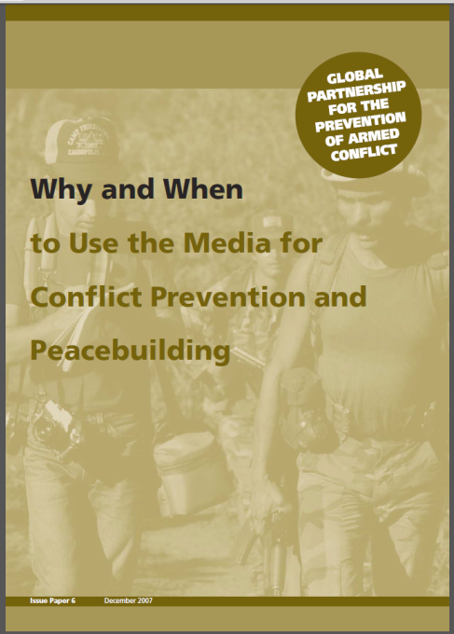
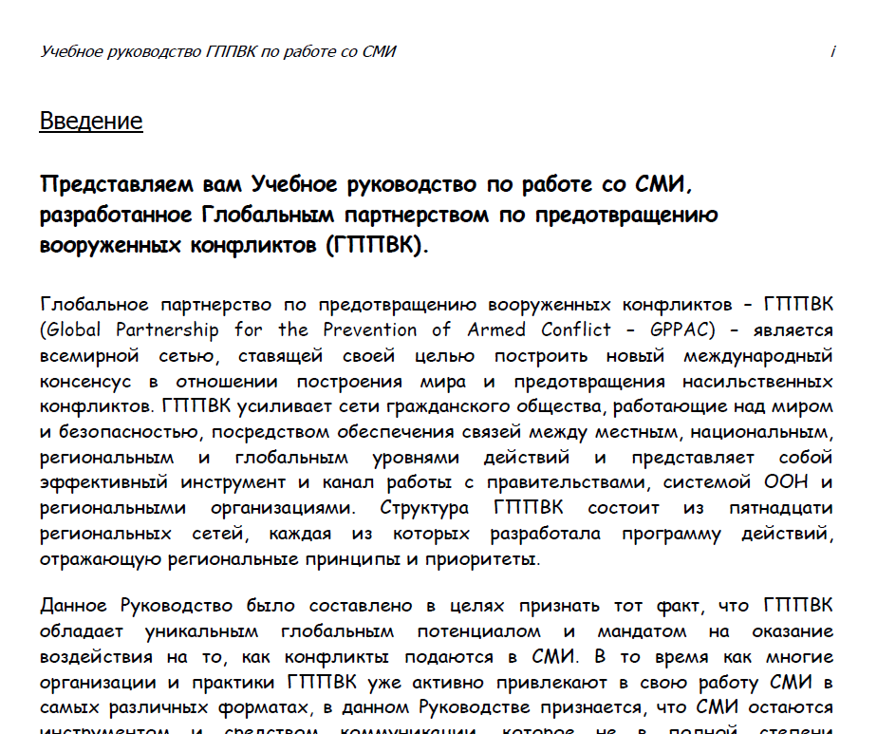
2011 - Geo-Russian Dialogue, June 28, 2011, Istanbul, Turkey;
2011 - Armenian-Azerbaijani Relations, problem of NKR, 3-4 December, 2011, Tbilisi, Georgia;
2012 - International Steering Group Meeting, 7-12 May, 2012, Tbilisi, Georgia;
2012 – Georgia and Russia: possibilities to restore relations: expert meeting; 16-17 November, 2012, Istanbul, Turkey
2012 - Peace Journalism, Peace Journalism training, June, 2012, Cyprus;
2013 - Creative methods for conflict resolution, December, 2013, Istanbul, Turkey;
2013 – Armenian-Azerbaijani relations: Perspectives for Problem Solving; meeting of young political leaders; 10-11 October, 2013. Tbilisi, Georgia
2013 - Peacebuilding and Peace Journalism South Caucasus meeting, May 2013, Tbilisi, Georgia
GPPAC 2009
GPPAC 2007

Slide 9
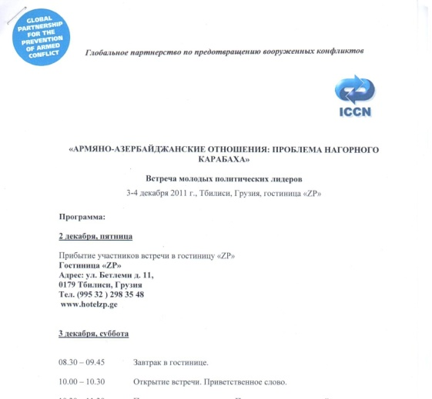
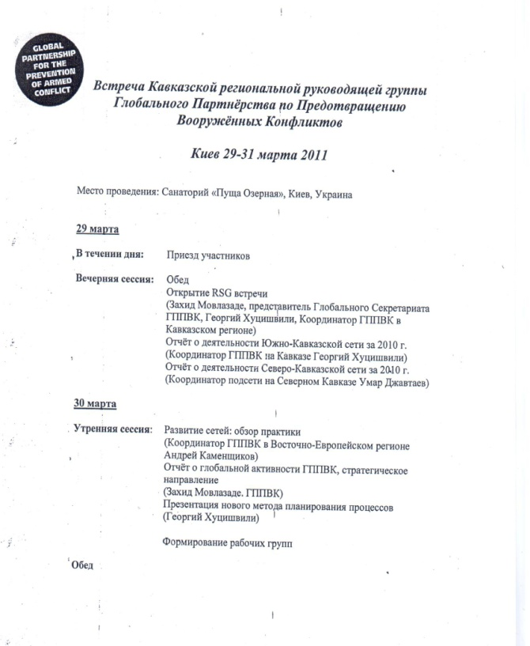
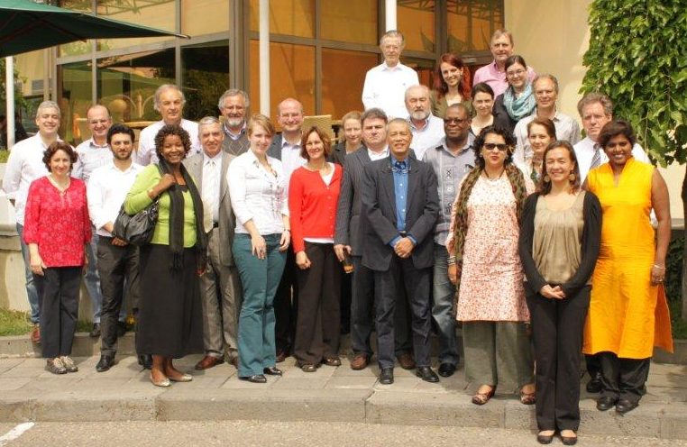
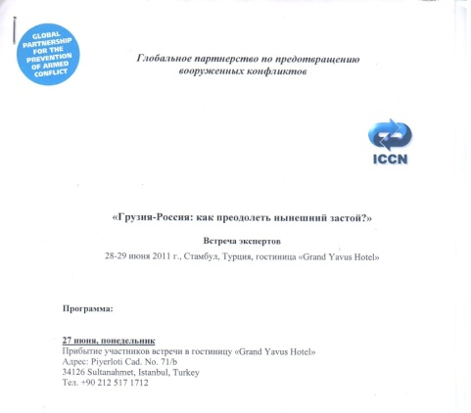
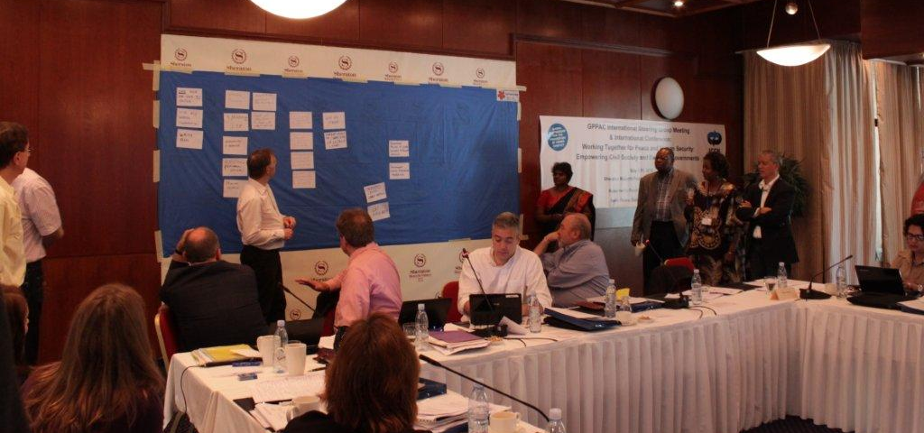
International Steering Group Meeting Tbilisi, Georgia (7-12 May, 2012);

Slide 10
2015 - GPPAC South Caucasian Conflict resolution and Management School of George Khutsishvili – one week training of South Caucasus Peace Journalism Participants, July, Misaktsieli, Georgia;
2015 - Gandhi Approaches to Peace – Peace Journalism, South Caucasus Participation, 30 March-3 April, Tbilisi, Georgia;
2015 - GPPAC South Caucasus Networking Meeting to identify strategic plan for the South Caucasus – SWOT analysis of peacebuilding in the region; Sept-October, Hurgada, Egypt;

Slide 11
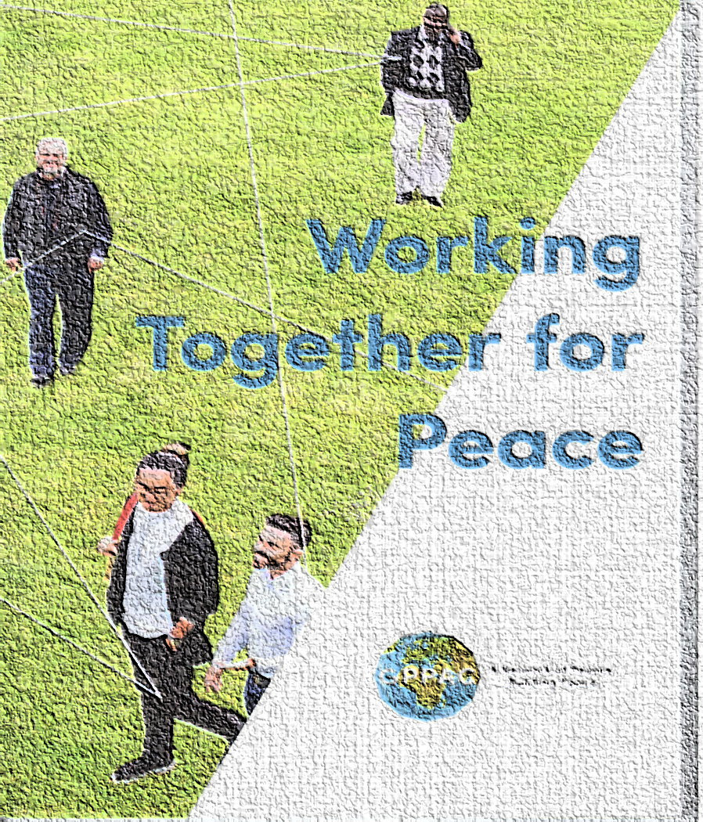
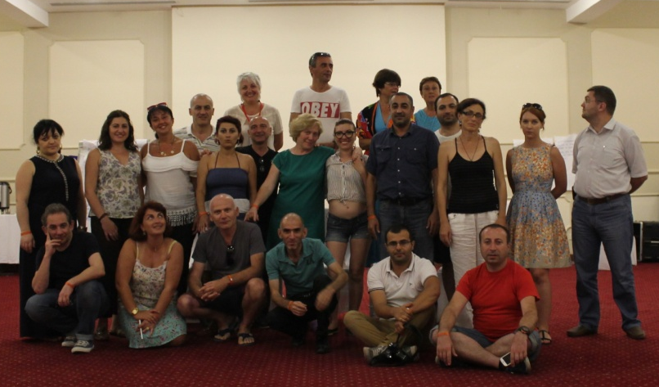
ICCN GPPAC South Caucasus Networking, October, 2015, Khugada, Egypt
ISG GPPAC 2012, Tbilisi, Georgia

Slide 12

2016 - Strategic Planning workshop, June 2016, Kyiev, Ukraine;
2017 – WOSCAP target countries: Georgia, Ukraine, Mali, Yemen – Assessing the EU’s Role in Conflict Resolution/Management, June 2017, Tbilisi, Georgia
2017 - Geo-Armenian Dialogue to find compatibilities between 2 trade and economic systems: of the EU and EaEU, Spring 2017, Tbilisi/Yerevan;
2017 - GPPAC South Caucasus Networking, November 2017, Istanbul, Turkey.

Slide 13

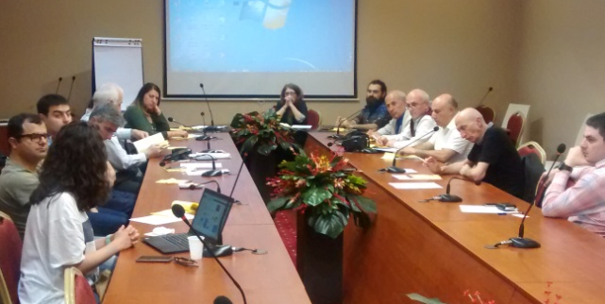
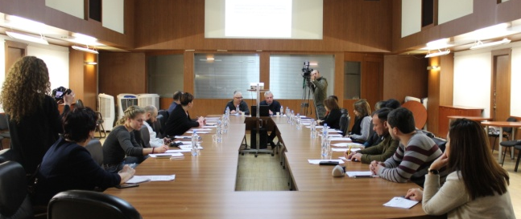

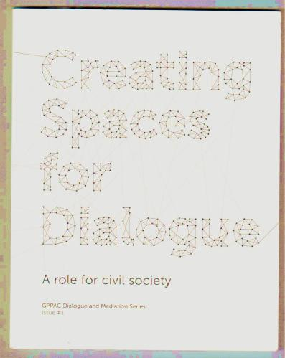
CSO & Media Dialogue Meeting, Yerevan, Armenia, 2017
CSOs & Media Dialogue Meeting, Tbilisi, Georgia, 2017
Creating Spaces for Dialogue, GPPAC 2015
WOSCAP 2016

Slide 14
2001-2017
ICCN – ECCP - GPPAC
South Caucasus
Activity Mapping
Caucasus Region
South Caucasus
GPPAC Caucasus Networking
North
Caucasus
Gender Focal Points
Regional Steering Group
Peace Journalism
the Dialogue:
A NK A R G A SO

Slide 15
Thank you!

