Slide 1

International Center on Conflict & Negotiation (ICCN)
South Caucasus Coalition for the ICC (SCICC)
The History of:
  Supporting to South Caucasus CSOs to Establish National Coalitions for International Criminal Court
  Foundation of the NGO Coalition for Support of ICC in Georgia
Prepared by ICCN. Documents Used Belong to ICCN’s Archive November, 2017 Tbilisi, Georgia

Slide 2
Shortly about ICCN
In spring 1994 the decision was made by the MacArthur Foundation to support the establishment of the International Center on Conflict and Negotiation in Georgia. The Founding Assembly was held in Tbilisi on August 8, 1994, which unanimously (63 signatures altogether) supported the establishment of ICCN. Dr. George Khutsishvili was granted the status of ICCN's founder. On November 3, 1994 the Ministry of Justice of Georgia registered ICCN as non-profit NGO (certificate #1755). ICCN was given the status of international organization according to the Georgian legislation because CISAC of Stanford University served in the first year after ICCN's establishment as an implementing partner of the project. Since then ICCN has been an independent contractor.
The activities of ICCN extend to the Caucasus region, with special emphasis on the situation in Georgia but participation also in wider networks and international projects. ICCN has been a co-founder of coalitions, international societies and centers, e.g. International Society for Fair Elections and Democracy, based in Tbilisi, Georgia; The South Caucasus Coalition for ICC (SCICC); The Caucasus NGO Forum for Peace and Non-violence in the Caucasus; The Caucasus Women's Research and Consulting Network (CWN), The South Caucasus Conflict Prevention and Peacebuilding Network under the Global Partnership for Prevention of Armed Conflicts (GPPAC), etc.
კონფლიქტების და მოლაპარაკებების საერთაშორისო კვლევითი ცენტრის არქივი
2017 წ. თბილისი, საქართველო

Slide 3
Shortly about the
RATIFICATION AND IMPLEMENTATION STATUS of the Rome Statute in Georgia:
Signature: 18 July 1998
Ratification: 5 Sept.2003
On 5 September 2003, Georgia deposited the instrument of ratification at the UN Headquarters becoming the 92 State to ratify the Rome Statute.
On July 16, on the instruction of the President, the Georgian Parliament had ratified by unanimity the Rome Statute.
A Working Group (activated by the Ministry of Justice) finished a draft legislative package for ratification and implementation in early April, which was first adopted by the inter-ministerial commission, then submitted to the Parliament.
On 14 August 2003, the Assembly passed a legislative package including:
1) bill on cooperation with the ICC;
2) Amendments to the Code of Criminal Procedure;
3) Amendments to the Criminal Code;
4) Amendments to the law on custody;
5) Amendments to the law on executive actions.

Slide 4
South Caucasus Coalition for the ICC (SCICC)
the history of development
2003-2010
კონფლიქტების და მოლაპარაკებების საერთაშორისო კვლევითი ცენტრის არქივი
2017 წ. თბილისი, საქართველო

Slide 5
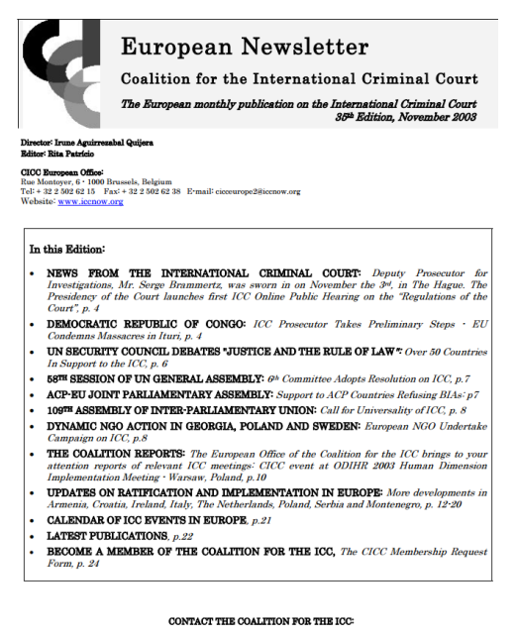
Creation of the Georgian NGO Coalition for the ICC
20th of October, 2003
Georgia: International Centre on Conflict and Negotiation:
Dr. George Khutsishvili, Director of the International Centre on Conflict and Negotiation (ICCN) has visited the International Criminal Court in The Hague, the Netherlands. Mr. Khutsishvili was invited by the Justice and Peace Commission, the Netherlands, to visit The Hague as member of the international expert meeting on the establishment of the Center for Justice and Reconciliation (CJR), a network organisation.
The International Center on Conflict and Negotiation initiated a gathering at the ICCN office of a number of Georgian NGOs and IO representatives on the 20th of October 2003 in order to discuss the role of Georgia, as a country that has recently ratified the Rome Statute of the ICC, in relation to the development of the Center of Justice and Reconciliation, and creation of the Georgian NGO Coalition for the ICC.
The participants at the gathering were Prof. George Khustishvili, Ms. Nina Tsihistavi, co-director of the Caucasus Women’s Network, Mr. Ucha Nanuashvili, leader of the Human Rights Information and Documentation Center, Mr. Nodar Topuridze and Mr. Zviad Tsagareishvili, representatives of the Georgian Center of International Criminal Law (GCICL), Ms. Natia Gvazava from the ICRC Delegation in Georgia, Mr. Marat Baratashvili of the Union of Georgian Repatriates (UGR) and Mr. Emil Adelkhanov of the Caucasus Institute for Peace, Democracy and Development (CIPDD). Consultations have also taken place with Ms. Nana Kakabadze, co-director of the NGO “Former Political Prisoners for Human Rights”, Ms. Nino Bakakuri of the Georgian Young Lawyers’ Association (GYLA), Mr. Alexander Russetsky, leader of the Georgian Helsinki Citizen’s Assembly and the South Caucasus Security Institute et al.
There was a generally positive response to the ICCN proposal to work on the action plan to establish a coalition of Georgian NGOs for the support of the ICC, which would take part in development and the work of the CJR.
This is an important indicator encouraging in seeking wider response from the Georgian civil society, especially CSO and NGO networks, as well as international organisations and missions operating in our country, towards creating a viable network of experts and organisations to promote the principles of the Rome Statute in our country and present in a qualified way burning issues for Georgia to the international community.
For more information, contact: ICCN [mailto:iccn@iccn.ge] .Press Release (23.10.2003).
http://archive.iccnow.org/documents/update35_nov2003.pdf
კონფლიქტების და მოლაპარაკებების საერთაშორისო კვლევითი ცენტრის არქივი
2017 წ. თბილისი, საქართველო

Slide 6
The Georgian NGO Coalition for the ICC
Mr. George Khustishvili, Ph.D, Director, ICCN
Ms. Shorena Lordkipanidze, Regional Coordinator of SCICC, ICCN
Mr. Ucha Nanuashvili, Chair, the Human Rights Information and Documentation Center (HRIDC),
Mr. Nodar Topuridze, the Georgian Center of International Criminal Law (GCICL),
Mr. Zviad Tsagareishvili, the Georgian Center of International Criminal Law (GCICL),
Ms. Natia Gvazava, the ICRC Delegation in Georgia,
Mr. Marat Baratashvili of the Union of Georgian Repatriates (UGR)
Mr. Emil Adelkhanov, the Caucasus Institute for Peace, Democracy and Development (CIPDD)
Ms. Nino Bakakuri, the Georgian Young Lawyers’ Association (GYLA),
Ms. Nina Tsihistavi, co-director, the Caucasus Women’s Network (CWN),
Mr. Alexander Russetsky, Chair, the Georgian Helsinki Citizen’s Assembly and the South Caucasus Security Institute (HCAG).
http://archive.iccnow.org/documents/update35_nov2003.pdf
კონფლიქტების და მოლაპარაკებების საერთაშორისო კვლევითი ცენტრის არქივი
2017 წ. თბილისი, საქართველო

Slide 7
The Programme to support
South Caucasus NGO Coalition for the Support of ICC 2005
WFM-CICC (WORLD FEDERALIST MOVEMENT)
The ICCN enhanced the cooperation with WFM-CICC. The project aimed at facilitating the establishment of an efficient coalition in South Caucasus for ratification and implementation of Rome Statute, as well as building good understanding of the role of ICC in the protection of human rights. The target groups of the project are: human rights groups, conflict prevention and management NGOs, relevant governmental structures (Ministry of Justice, Constitutional Court, Supreme Court, the judiciary committee of the parliament and etc.) and think tanks.
The expected results of the project are the following:
Formation of national and regional coalitions for the support of ICC;
Creation of working groups defining strategy of the coalition on the regional level;
Civic education aimed at ICC awareness through common regional strategy towards International Criminal Court.

Slide 8
The Conference on the ICC in Baku on April 5-6, 2006,
Azerbaijan has not yet signed or ratified the Rome Statute of the International Criminal Court (ICC), however it has demonstrated its commitment to international justice and the fight against impunity by including some provisions of the Rome Statute into the new Criminal Code that entered into force on September 1, 2000. This Criminal Code provides for criminal responsibility for crimes against humanity and war crimes, reflecting the definitions of the Rome Statute.
More recently the Ministry of Justice of Azerbaijan has expressed interest in holding a conference on the ICC in Baku on April 5-6, 2006, that is being organized by the Georgia-based International Center on Conflict and Negotiation (ICCN), the coordinator of the South Caucasus Coalition for the ICC.
http://iccnow.org/?mod=urc0406
კონფლიქტების და მოლაპარაკებების საერთაშორისო კვლევითი ცენტრის არქივი
2017 წ. თბილისი, საქართველო

Slide 9
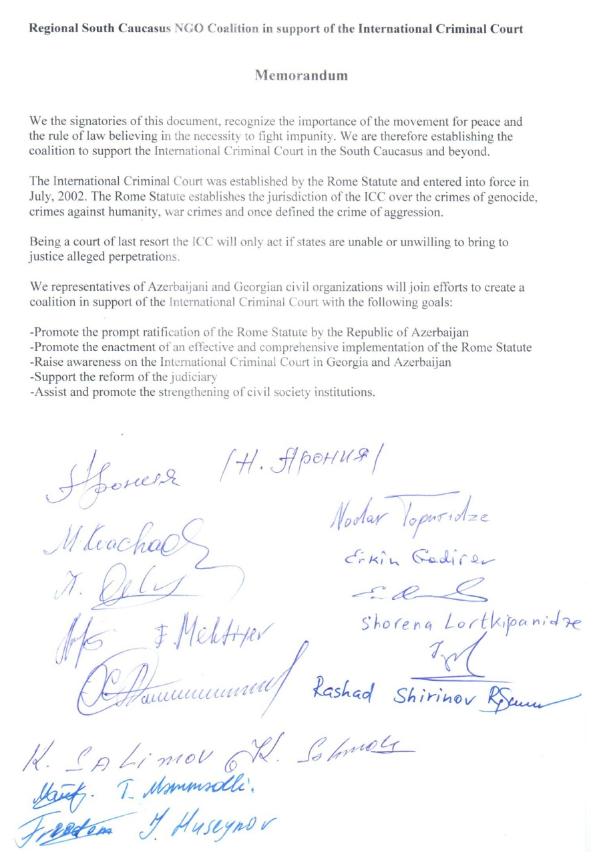

Azerbaijan 2006
The Memorandum Between Azerbaijani and Georgian Civil society Organizations to Establish The Coalition to support the ICC in the South Caucasus and Beyond, Signed in Baku, Azerbaijan, on 4 April, 2006.
the Goals:
to promote and prompt ratification of the Rome Statute by Republic of Azerbaijan;
to promote the enhancement of an effective and comprehensive implementation of the Rome Statute;
to rise awareness on the ICC in Georgia and Azerbaijan;
to support the reform of the judiciary;
to assist and promote the strengthening of civil society institutions.
კონფლიქტების და მოლაპარაკებების საერთაშორისო კვლევითი ცენტრის არქივი
2017 წ. თბილისი, საქართველო

Slide 10
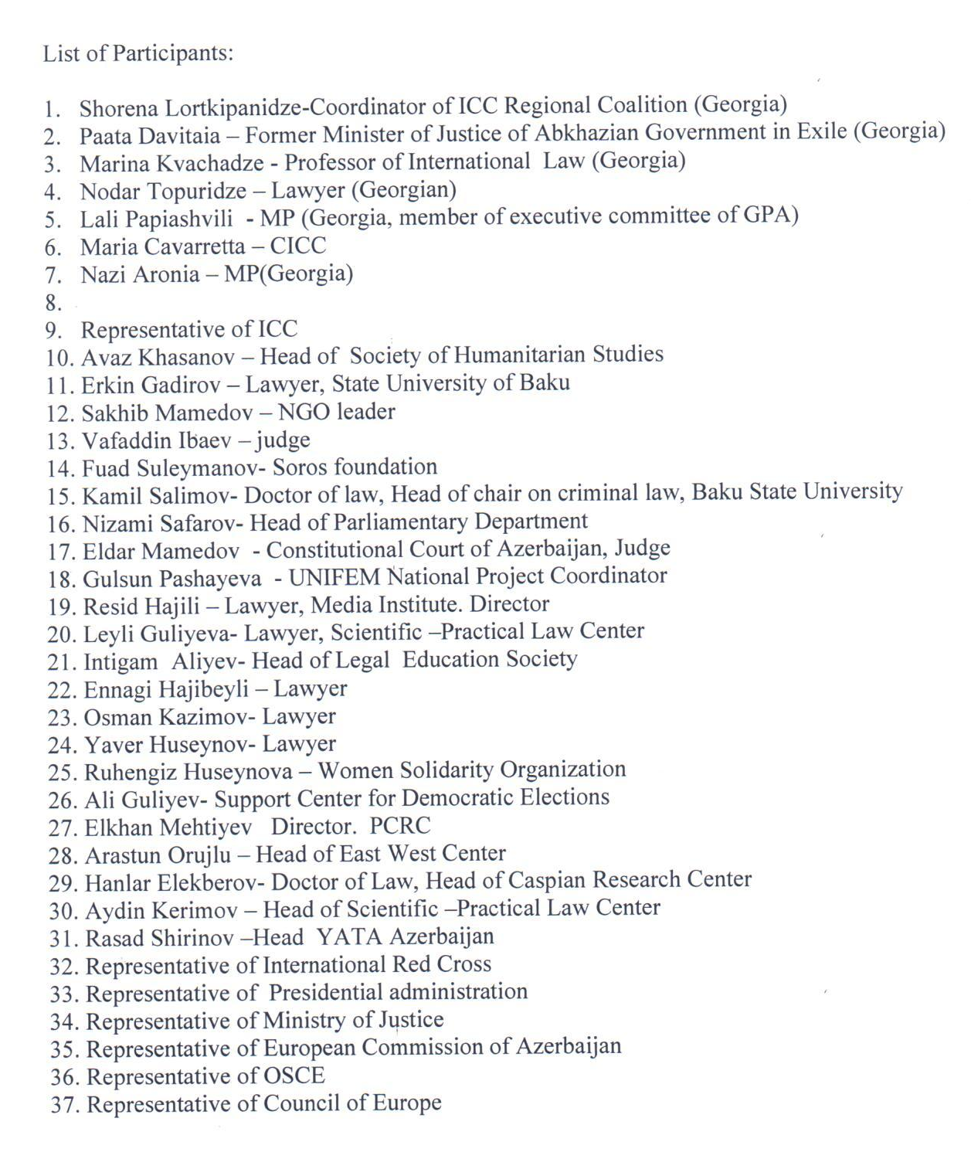
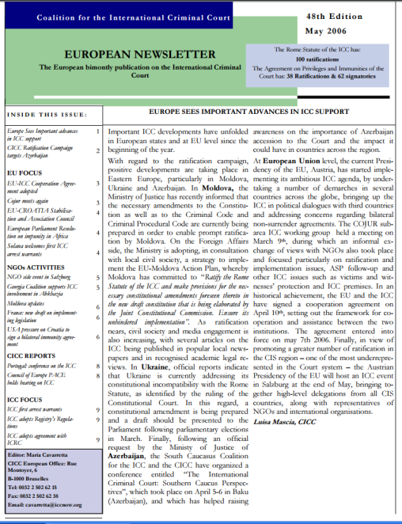
The List of Participants,
Baku, Azerbaijan, 5-6 April, 2006
The South Caucasus Coalition for the ICC (SCICC) and the CICC have organized a conference entitled “The International Criminal Court: Southern Caucus Perspectives”, which took place on April 5-6 in Baku (Azerbaijan), and which has helped raising awareness on the importance of Azerbaijan accession to the Court and the impact it could have in countries across the region.
http://www.iccnow.org/documents/euroupdate48_May2006.pdf
კონფლიქტების და მოლაპარაკებების საერთაშორისო კვლევითი ცენტრის არქივი
2017 წ. თბილისი, საქართველო

Slide 11
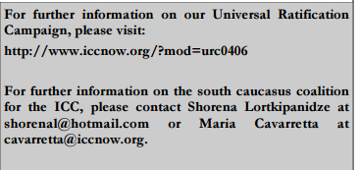
To provide full support to the Azeri counterparts for the promotion of the ICC ratification and implementation
In a letter sent to the President of Azerbaijan H.E. Ilham Aliyev and the Prime Minister of Azerbaijan H.E. Artur Tahir oğlu Rasizadə, the CICC called on Azerbaijan to accede to the Rome Statute of the International Criminal Court (ICC) in order to demonstrate its full commitment to international justice and the global fight against impunity. In writing to Mr. Rasizadə and Mr. Aliyev, the Coalition welcomed the recent expressions of interest of the Azeri Ministry of Justice in exploring ICC accession by supporting the organisation of the Conference on the ICC.
The conference “The International Criminal Court: Southern Caucasus Perspectives” organized by the Georgia-based International Center on Conflict and Negotiation (ICCN), the coordinator of the South Caucasus Coalition for the ICC with the support of the CICC was attended by around 30 participants coming from Georgia and Azerbaijan including: NGOs, academics, lawyers, Members of Parliament, the Azeri Ministry of Foreign Affairs, ICRC, UNDP, UNIFEM project, CICC, and the legal advisor of the Presidency of the ICC.
The conference started with a general overall presentation on the ICC jurisdiction, its current activities and challenges as well as the values and principles embodied in the Rome Statute. Georgian NGOs, academics and Members of Parliament invited to the conference made presentations on the work carried out by them to obtain the prompt ratification and full implementation of the Rome Statute by Georgia, and put forward that Azerbaijan faces problems that could overcome with similar solutions.
The Georgian participants also put forward their willingness to provide full support to the Azeri counterparts for the promotion of the ICC ratification and implementation. In this regard, a joint memorandum was signed by the participants who committed themselves to take actions for the promotion of ratification and full implementation of the Rome Statute in Azerbaijan and Armenia. Strong commitment is needed from national civil society organisations in Azerbaijan, from neighbouring countries and international organisations to increase pressure on the government to put the ICC on the political agenda.
http://www.iccnow.org/documents/euroupdate48_May2006.pdf p.2
More on the South Caucasus Coalition for the ICC -
Ms. Shorena Lordkipanidze, Coordinator, ICCN
or Maria Cavaretta, CICC
კონფლიქტების და მოლაპარაკებების საერთაშორისო კვლევითი ცენტრის არქივი
2017 წ. თბილისი, საქართველო

Slide 12
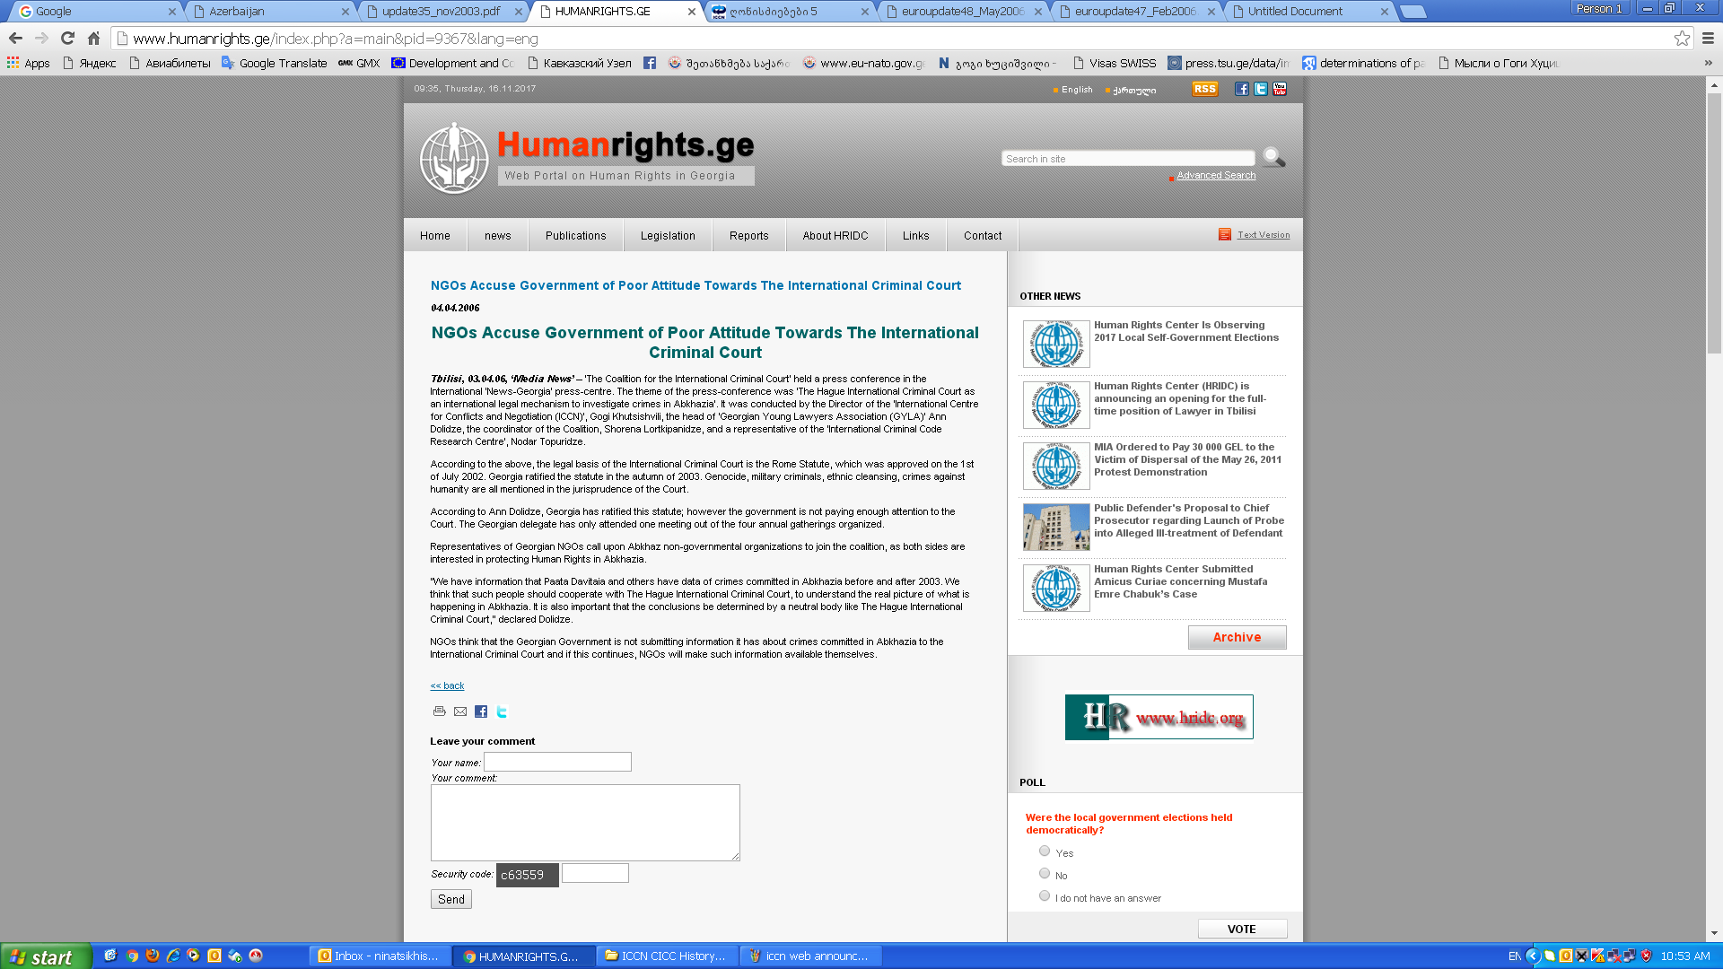
GEORGIA AND THE ICC 4 March, 2006
Mr. Paata Davitaya, the former justice minister of Abkhazia in-exile and leader of the NGO ‘We Ourselves Movement’ was reported to have submitted information to the Office of the Prosecutor (OTP) of the ICC with regard to crimes committed in Abkhazia, a region of Georgia. The Georgian coalition for the ICC has decided to fully support Mr. Davitaya in its endeavor to call on the ICC to start investigating the crimes committed in Abkhazia.
Local civil society reports that in a confidential letter sent to Mr. Davitaya by the OTP, the Prosecutor informed that some of the crimes committed in Abkhazia could fall under the jurisdiction of the ICC and additional evidence in form of documentation has been requested.
A press conference on the matter has been organised by Mr. Davitaya and the Georgian coalition and, several articles have been published in this regard.
Participants included the head of Tbilisi International Center for Conflict and Negotiation, George Khutsishvili, the chairwoman of the Young Lawyers’ Association, Ana Dolidze and coordinator of the coalition, Shorena Lortkipanidze. Other member organisations of the coalition are the Human Rights Documentation and Information Center, the International Crime Research Center and the Caucasus Institute for Peace and Development.
The Georgian Coalition for the ICC stated its support for the court’s involvement in Abkhaz issues and presented the NGOs strategy to put pressure on the Georgian government to support the request of the Court to provide the needed documents to the ICC and calling on the Abkhaz colleagues to join the national coalition in the efforts made in this regard.
For more information, please contact: s h o r e n a L o r t k i p a n i d z e a t shorenal@hotmail.com.
http://www.iccnow.org/documents/euroupdate48_May2006.pdf
Tbilisi, 03.04.06, ‘Media News’ http://www.humanrights.ge/index.php?a=main&pid=9367&lang=eng
კონფლიქტების და მოლაპარაკებების საერთაშორისო კვლევითი ცენტრის არქივი
2017 წ. თბილისი, საქართველო

Slide 13
Europe Sees Important Advances in ICC Support
Following an official request by the Ministry of Justice of Azerbaijan, the South Caucasus Coalition for the ICC (SCICC) and the CICC organized a conference entitled “The International Criminal Court: Southern Caucus Perspectives” which took place on 5-6 April 2006 in Baku, Azerbaijan, and which has helped raise awareness of the importance of Azeri accession to the Court and the impact it could have in countries across the region.
The International Criminal Court MONITOR • May 2006, Page 10
http://www.iccnow.org/documents/Monitor32eng_WebFinal.pdf

Slide 14
Developments in Armenia, Azerbaijan, Georgia as for 2006-2008
The creation of a Regional Coalition is important for developing regional approach to ICC and for building up the platform for ensuring the development of strong implementing legislation in the South Caucasian Republics. Generating regional public support for the court is also crucial.
A very important element of the initiative is assisting/supporting the process of ratification of the Statute in Armenia and Azerbaijan through involving civil society actors, maintaining the cooperation among state and non-state actors on both country and regional levels.
კონფლიქტების და მოლაპარაკებების საერთაშორისო კვლევითი ცენტრის არქივი
2017 წ. თბილისი, საქართველო

Slide 15
Developments in Armenia, Azerbaijan, Georgia as for 2006-2008
Target Countries:
Armenia, Azerbaijan, Georgia
Target Groups:
NGOs (leading human rights organization, democracy, civil society, conflict management, conflict prevention and resolution groups), relevant State Structures in charge of ICC issues in the Caucasus States, academic Circles (think tanks, research institutions) and practical lawyers.
Goal of the Project:
The main goal of the project is to create regional coalition for support of ICC in the South Caucasus region for the ratification and implementation of ICC and for the involvement of civil society groups in the ICC process.
Activities and Places: Tbilisi, Yerevan, Baku:
Collecting materials for the web-site of the regional coalition, setting up Armenian and Azerbaijan coalitions;
Organising roundtables in Armenia, Azerbaijan and Georgia, starting organising public awareness activities: radio programmes, TV Programme;
Preparing the written Analysis and comparing analysis paper that will cover the NGO work in Armenia, Azerbaijan and Georgia and assess relevant state organisations’ involvement in the ICC process. All the reports and the assessments will serve as the materials for the South Caucasus ICC Coalition web-site.
კონფლიქტების და მოლაპარაკებების საერთაშორისო კვლევითი ცენტრის არქივი
2017 წ. თბილისი, საქართველო

Slide 16
Thematic Working Groups (WG)
Under the Georgian NGO Coalition for ICC
WG with the Parliament of Georgia (focal point Ms. Nazi Aronia, Ms. Lali Papiashvili)
WG with the Ministry of Justice of Georgia (focal point Mr. Gocha Lordkipanidze)
WG with the Supreme Court of Georgia (focal point Mr. Merab Turava)
The regular work within the WGs was to harmonize legislation and provide with recommendation the stakeholders and the society towards the open discussions related to the issues under the ICC and the Rome Statute in Georgia and South Caucasus

Slide 17
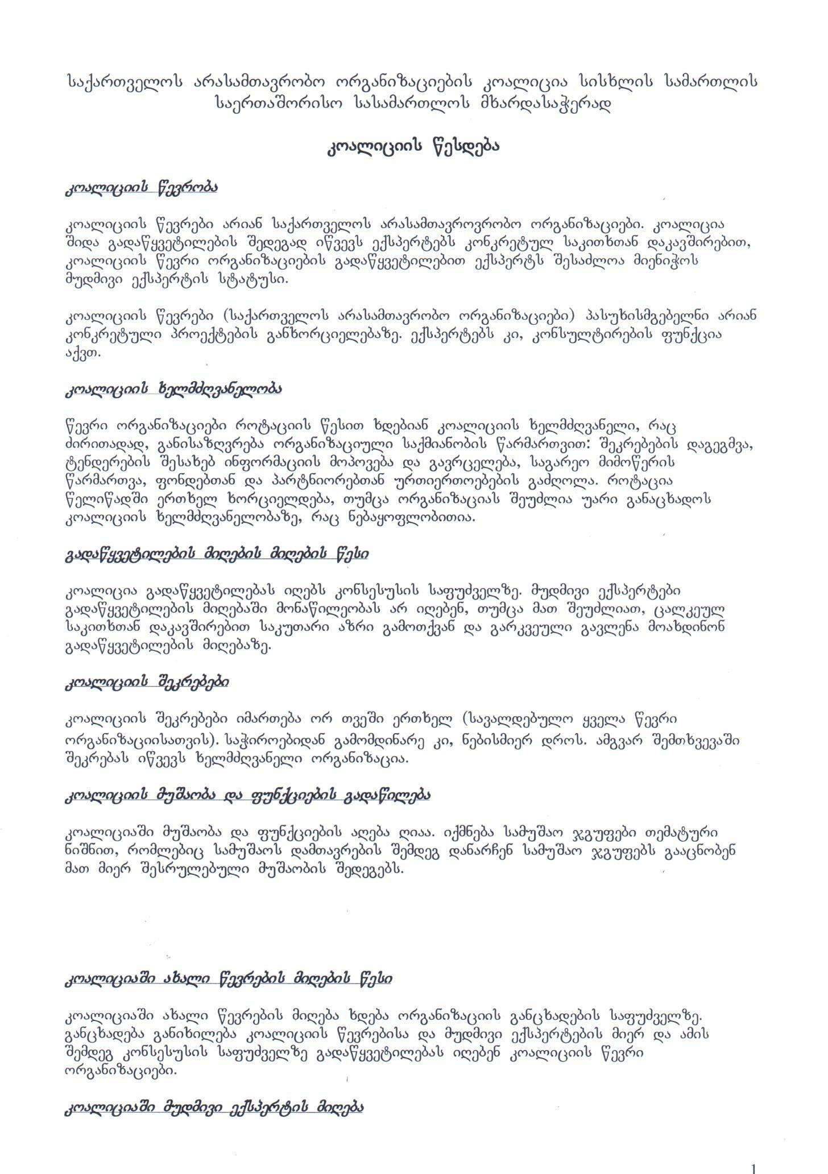

კონფლიქტების და მოლაპარაკებების საერთაშორისო კვლევითი ცენტრის არქივი
2017 წ. თბილისი, საქართველო
2010
საქართველოს არასამთავრობო ორგანიზაციების კოალიცია სისხლის სამართლის საერთაშორისო სასამართლოს მხარდასაჭერად
კოალიციის წესდება
თბილისი, საქართველო,
2010 წ.

Slide 18
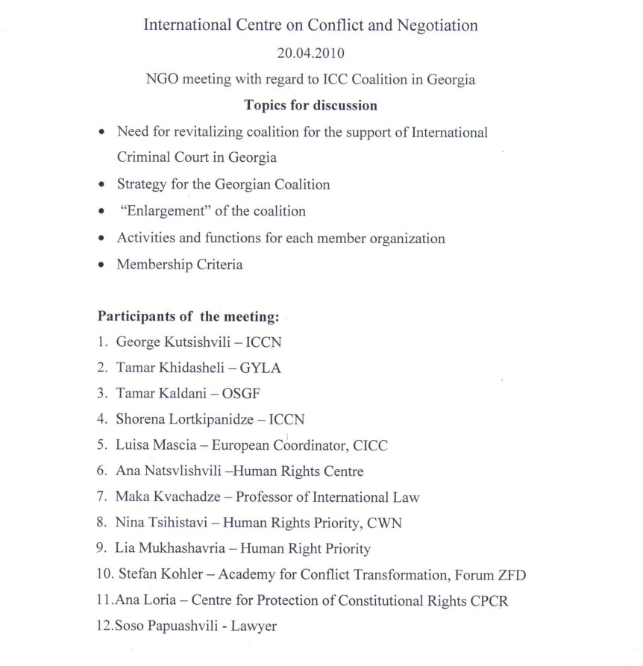
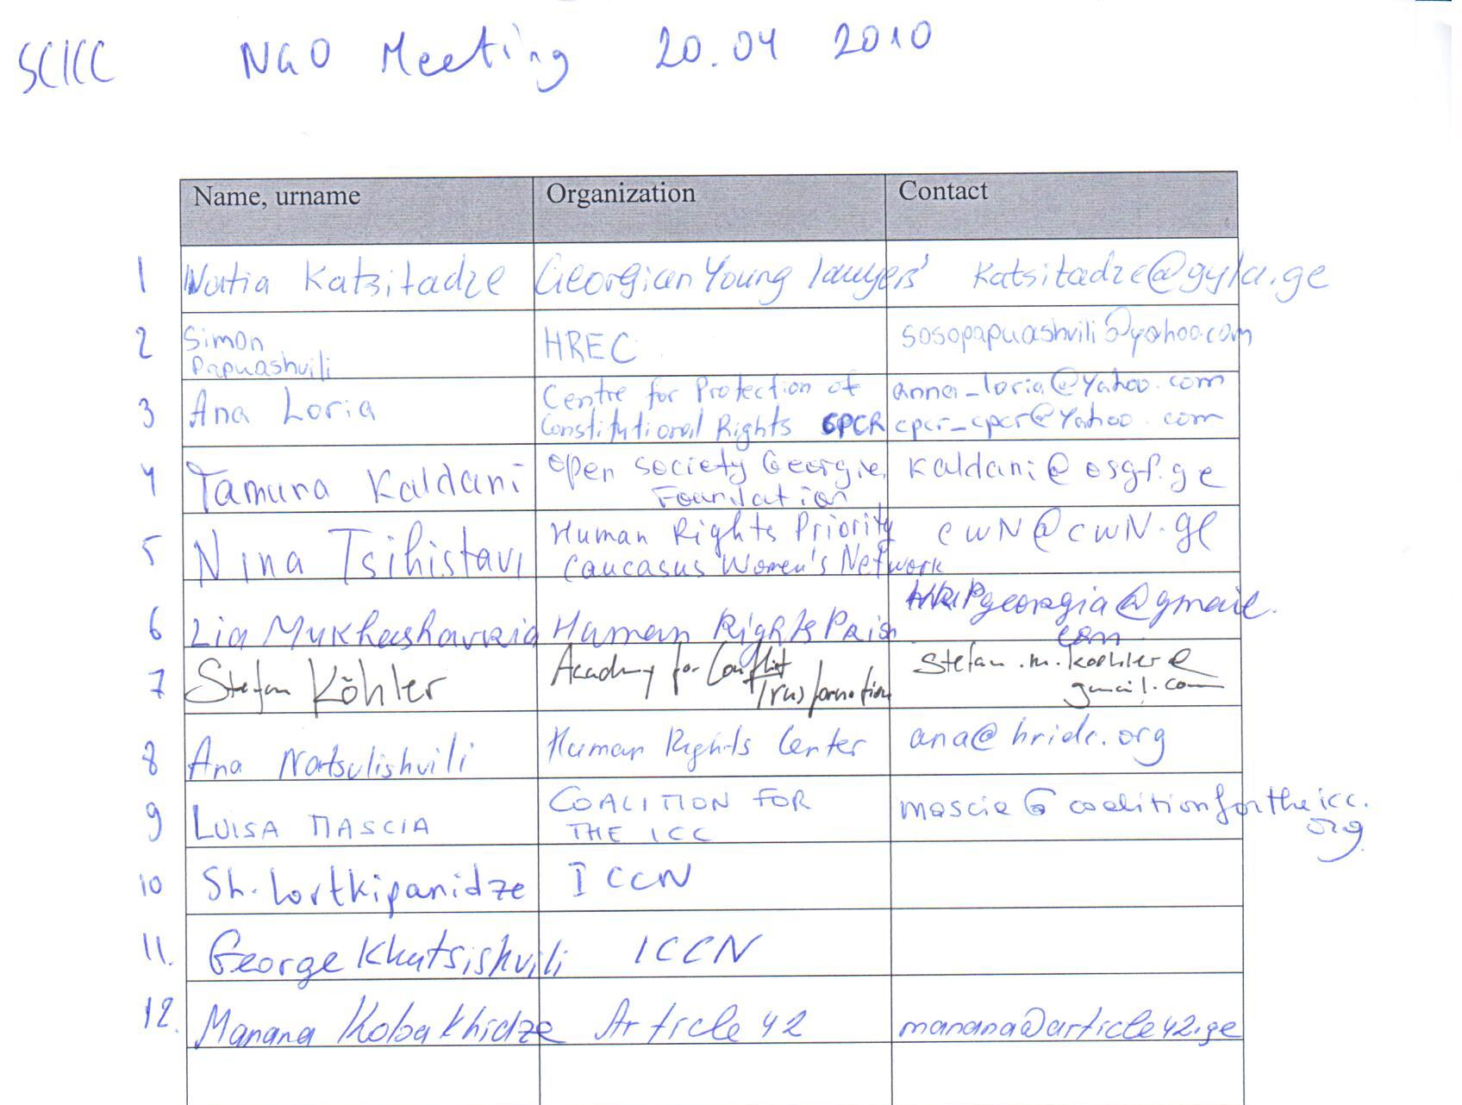
ა/ო შეხვედრა კოალიციის საკითხებზე 20/04/2010
საქართველოს არასამთავრობო ორგანიზაციების კოალიცია სისხლის სამართლის საერთაშორისო სასამართლოს მხარდასაჭერად
კონფლიქტების და მოლაპარაკებების საერთაშორისო კვლევითი ცენტრის არქივი
2017 წ. თბილისი, საქართველო

Slide 19
საქართველოს არასამთავრობო ორგანიზაციების კოალიცია სისხლის სამართლის საერთაშორისო სასამართლოს მხარდასაჭერად
2010 წელს კოალიციის წევრთა საერთო კრების გადაწყვეტილების თანახმად, კოალიციის ხელმძღვანელობა გადავიდა ახალგაზრდა იურისტთა ასოციაციაში.
კონფლიქტების და მოლაპარაკებების საერთაშორისო კვლევითი ცენტრის არქივი
2017 წ. თბილისი, საქართველო

Slide 20
მადლობა გაწეული შრომისა
და თქვენი ყურადღებისთვის!
ninatsikhistavi@iccn.ge
კონფლიქტების და მოლაპარაკებების საერთაშორისო კვლევითი ცენტრის არქივი
2017 წ. თბილისი, საქართველო

