Slide 1
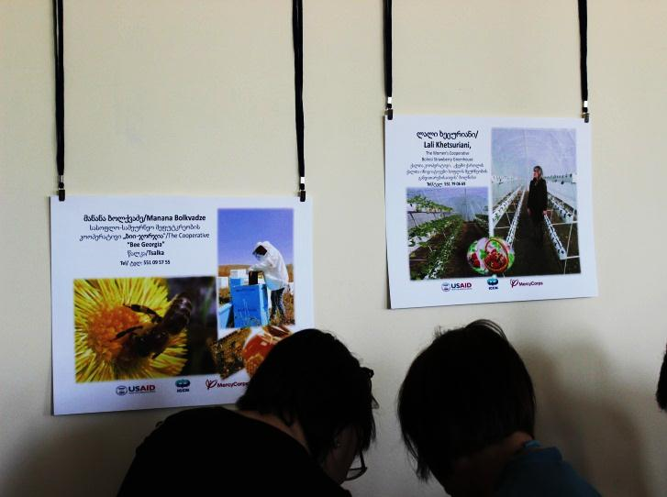
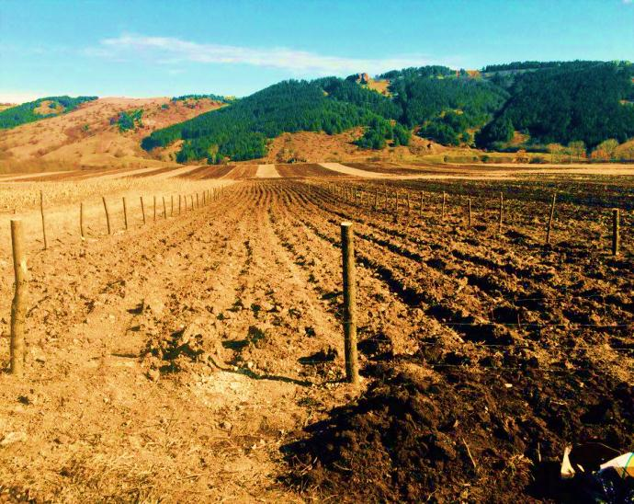
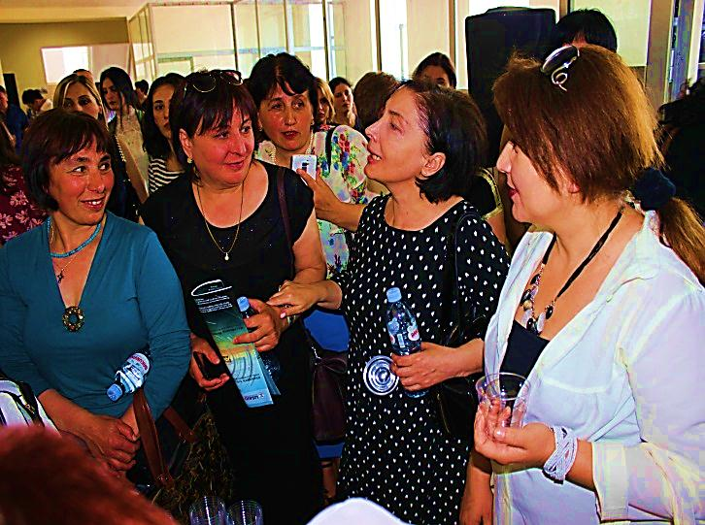
International Center on Conflict and Negotiation
Broadening Horizons: Improved Choices for the Professional and Economic Development of Women and Girls
APS Number: APS-114-A-13-00007
2016 SECOND QUARTERLY REPORT
April 1, 2016 – June 30, 2016

Slide 2
Executive Summary This quarterly report is the second quarterly report in 2016 prepared in the frames of the Annual Work Plan dated by Apr.1; 2016-June.30, 2016 in accordance with the Cooperative Agreement reference No. APS-114-A-13-00007 – “Broadening Horizons: Improved Choices for the Professional and Economic Development of Women and Girls” signed on September 24, 2013. This quarterly report analyzes the activities and results delivered during the period from 1 April, 2016 through 30 June, 2016. In addition to achieved results, it also summarizes the Program progress while moving to its extended end in October, 2016, as the initial timeframe of the Program was prolonged through a non-cost extension approved by Donor. Program Objectives The goal of the proposed program is to have increased involvement in and benefit from educational, professional and economic opportunities for women and girls. The main objectives are:- 2000 women and 1000 girls in municipalities have increased participation in decision making at community and municipal levels; - 3000 women and girls in 13 municipalities able to make more informed choices based on increased access to information and services in the areas of education, training, employment, and professional development. Component 1 – Women’s Rooms As of 30th June, 2016, overall 13 Women’s Rooms are opened and functioning in the all targeted municipalities: Ninotsminda, Adigeni, Akhalkalaki, Borjomi, Dmanisi, Bolnisi, Marneuli, Rustavi, Tetritskaro, Tsalka, Aspinda, Akhaltsikhe and Gardabani. WR Managers in all 13 municipalities are equipped with relevant knowledge and skills to run the WRs and ensure proper functioning of this new municipal service created under the Program. The Gardabani WR Opening Ceremony was attended by the Kvemo Kartli Governor and local Gamgebelis and other invited guests, which is a good evidence of government's support and interest in development and promotion of such services for addressing Gender issues in the region. All 13 WRs are serving as a center for resources and information, where the program needs-based trainings, English and IT Learning Courses are being held. The Program seeks linkages with other organizations, programs, projects and private sector to tie up with the WRs and established businesses through grants to meet the priority needs of the women in the local area. Component 2 – The Education, Career and Opportunities Fund (ECF) The Education, Career and Opportunities Fund (ECF) started its operations since October, 2014. It offers small scale grant programs to women and girls. ECF targets 3 groups, namely: (1) High school students - girls and boys (age of 15-18); (2) Rural Women; (3) Women. There has been several calls for applications announced during the program implementation and all grants were disbursed and procured by the end of October, 2015. All 29 youth grants and 13 small business grants were already implemented; The English language and IT courses are over in the WRs and completion certificates are delivered to the participants. Series of trainings in Leadership for Women completed. Component 3 – Education and School Component In order to raise awareness of youth on higher education and career opportunities, majors there were conducted informational meetings in Kvemo Kartli and Samtskhe-Javakheti regions. In total During the reporting period there was provided information to 739 youth, among them 373 girls.

Slide 3
Component 1 – Women’s Rooms
Ninotsminda Women’s Room
Ninotsminda Women’s Room was fully operational for the reporting period. It hosted training programs in English Language and Information Technologies organized through the grants for rural women, information meetings with beneficiaries and grantees.
Ninotsminda needs: courses in sewing, needlework, agritourism, management, vehicle driving lessons. Besides during the previous reporting period there were revealed the following needs: digital camera, information about employment opportunities, a mirror, more often trainings, speakers for computer, linkages regarding the gender issues, more meetings and trainings on small business, more books for the library and toys. In addition, it was needed to conduct more meetings on small business development, Gender issues, Trainings and meetings with specialists. It is very difficult for community members to cover transportation expenses to attend WR activities, therefore they need support. The most demanded services at Ninotsminda WR is attending the trainings. Lusine Nazaryan was employed by the WR during three months – internship. Additionally, after renewing of English knowledge through conducted courses at WR, two women Emma Khanbekyan and Anush Tovmasyan have started teaching English to elementary school children. The information about the WR mainly was received through friends and radio. After that Anush Tovmasyan has moved to the local radio. The information about the WR mainly was received through friends and radio. The most demanded service at the WR is Children’s corner and different services. The memorandum on cooperation was signed with the young lawyer association.
Events organized by Ninotsminda Women’s Room:
Month | Even | Women | Total
May16 | Working meeting with the colleagues from the cultural department of Ninotsminda Municipality | 8 | 9

Slide 4
Component 1 – Women’s Rooms
Marneuli Women’s Room
Marneuli Women’s Room was fully operational up today. It hosted different training programs in English Language and Information Technologies organized through the grants for rural women, information meetings with beneficiaries and grantees. Marneuli WR is quite active not only in taking part in village meetings for local budget planning, but also initiating and organizing them. Due to such active WR engagement, women’s participation in local budget planning has been increased.
Marneuli WR needs: During the current reporting period there were not revealed additional needs. Besides during the previous reporting there were revealed the following needs: information about the trainings conducted through internet, need in training conduction, exchange information between the town and villages, network with youth. At Marneuli WR the most demanded services are the use of computer and consultations. The information about the Women’s Room was mainly received through the municipality.
Events organized by Marneuli Women’s Room:
Month | Event | Women | Total
May16 | Information meeting on early marriage, violence against women and women rights in Algeti Administraive Unit | 3 | 18
May 16 | Information meeting on early marriage, violence against women and women rights in Sadakhlo Administraive Unit | 250 | 443
June16 | Meeting with the Ethnical Minority students on the issue of language barrier | 3 | 5
June16 June 16 | Information meeting on WR with students from Marneuli Information meeting Civil budget with Municipality employees, the guest from Poland and other stakeholders | 9 2 | 9 26

Slide 5
Component 1 – Women’s Rooms
Rustavi Women’s Room
Rustavi Women’ s Room was fully operational since its opening and it hosted different training programs, inter alia, courses in English Language and Information Technologies organized through the grants for rural women, information meetings were also organized through WR support with beneficiaries and grantees of other programs
Rustavi needs: consultancies on psychological issues-“relationship between youth and parents” and consultancies on the land and property registration issues. Beside during the previous reporting there was revealed need in information on existing vacancies, employment of young mothers, registration of children at the kindergartens, more information about media, social networks, and meetings with youth girls on different themes, linkages and trainings regarding gender issues, with lawyer and women’s rights, and English language courses and Georgian language. The WR has helped Elnara Isaeva to resolve the problem with natural gas delivery to her flat. The most demanded services are consultancies on different issues. Visitors find out about the Women’s Room mainly from TV and social networks..
Events organized by Rustavi Women’s Room:
Month | Event | Women | Total
Apr 16 | Informational meeting on the mortgage loan issue Informational meeting on the marriage, divorce and the relevant procedures and rights of the parties | 14 6 | 14 6
May 16 | Informational meeting with the ethnical minorities on the marriage, divorce and the relevant procedures and rights of the parties Informational meeting with the housewives on the land registration procedures | 15 14 | 15 14

Slide 6
Component 1 – Women’s Rooms
Adigeni Women’s Room
Adigeni Women’s Room was fully operational as of today. It hosted different training programs, inter alia, courses in English Language and Information Technologies organized through the grants for rural women, information meetings with beneficiaries and grantees.
Adigeni needs: trainings on different themes, vehicle driving courses and business development trainings. During the previous reporting period there were also needed courses for certification of teachers, accounting, computer, English, craft courses, delivery of information more broadly to the villages, advices to young mothers, information on business planning, teachers’ trainings, connection with businesses, connection with cultural department of other municipality, information on women employment and exchange of information on agricultural issues, stylist, makeup artist and designer courses, information of ecological issues, driving lessons, cooking lessons, computer classes and trainings. Besides there were needed connections with beekeepers, gardeners, florists. The WR is in need of photo camera, projector and the board. The WR has signed the Memorandum on cooperation with the Young Lawyers Association. At Adigeni WR the most demanded services are computers. Visitors find out about the Women Room mainly from WR Manager and information sources. .
Events organized by Adigeni Women’s Room:
Mnth | Event | Women | Total
June 16 | Celebration of the international children’s day. |  | 100

Slide 7
Component 1 – Women’s Rooms
Aspindza Women’s Room
Aspindza Women’s Room was fully operational up to date. it hosted different training programs, inter alia, courses in English Language and Information Technologies organized through the grants for rural women, information meetings with beneficiaries and grantees.
The program team together with the Women’s Rooms revealed women willingness to take English and computer courses. In the frame of the grant component aimed at support of rural women it was decided to transfer these grants into the English and Computer lessons.
Aspindza needs: There is a need in computer and English courses, different trainings and course on the work on wood. Besides, during the previous reporting period there was needed consultation of the psychologist., fast learning courses in foreign languages, information on women and children rights, child raising at awkward age, consultancies in professional development, involvement into the discussions, networks to exchange the information and needlework. The most demanded service at the WR is consultancy and other services. Visitors find out about the Women Room mainly from Municipality.
Events organized by Aspindza Women’s Room:
Month | Event | Women | Total
May 16 | Informational meeting on immunization | 18 | 18

Slide 8
Component 1 – Women’s Rooms
Akhalkalaki Women’s Room
Akhalkalaki Women’s Room was fully operational during the reporting quarter. It hosted different information meetings and training programs, inter alia, courses in English Language organized through the grants for rural women, information meetings with beneficiaries and grantees. Akhalkalaki expressed interest only in English courses so it was decided to conduct only English course and prolong it by one month instead of computer classes.
Akhalkalaki needs: There is need in training for kindergarten teachers, which will be teaching kindergarten children in the villages. Besides during previous months, it was revealed need in Lawyer and psychological support, economic and social support of women, information on the similar centers in developed countries, which conduct social and economic projects, information on gender issues/problems, women rights protection. Besides, according to WR managers the trainings are needed for teachers who have students involved into inclusive education. The most demanded service at the WR is the space of WR and computer services. The Women’s Room also requires a digital camera. Visitors find out about the Women Room mainly from WR Manager. The WR was approached by two persons with disabilities, who needed wheelchairs. With help of the WR manager these wheelchairs will be granted to mentioned people by the municipality. The memorandum on future cooperation was signed between the WR and the young lawyers’ association..
Events organized by Akhalkalaki Women’s Room:
Month | Event | Women | Total
June 16 | Meeting of the multi-discipline group on Inclusive education of children with disabilities | 16 | 18

Slide 9
Component 1 – Women’s Rooms
Borjomi Women’s Room
Borjomi Women’s Room is fully operational as of today. It served municipality staff for providing space for their events.
Borjomi needs: During the reporting period there were not revealed any additional needs except for consultancies. According to the previous reports there were needed: puffy toys for small children and playpen, consultation of the psychologist, projector for presentations, books for library, besides information on demographic issues and young family support issues. Also from the previous reports the needed networks by women were networks with business coordinators, organizations working on children disability issues and Women international organizations. The most demanded services at the WR are computer services and consultancy. Visitors mainly find out about the Women Room from municipality and friends. The women from Borjomi municipality are asking for additional courses in IT, as it is very necessary for them and the number of interested is very big. With help of Borjomi WR, Marina Spitari met the Head of Sakrebulo and as a result of this meeting has resolved the problem, which had been exited for a long time.

Slide 10
Component 1 – Women’s Rooms
Dmanisi Women’s Room
Dmanisi Women’s Room was fully operational during the reporting quarter of 2016. It hosted different training programs, information meetings with beneficiaries and grantees, Women’s Participation in village gatherings is steadily increasing, which can be attributed to the decent performance of the municipal service – Women’s Room.
Dmanisi needs: During the reporting period there were not revealed any additional needs for Dmanisi municipality. According to previous reports there were needed: Psychological trainings, trainings, awareness rising of men about the WR and their right to use it, courses in the development of style, introduction of Women rights to rural women in the villages, consultation of the psychologist, harmful influence of the computer, educational, agricultural and other trainings. The most demanded service at the WR is computer service. Visitors find out about the Women Room mainly from municipality/gamgeoba and friends. The WR has arranged a charity concert, aimed at supporting of 2-year girl with cancer. All the collected money was transferred to the relevant account. As a result of the business training, conducted by the Broadening Horizons program, Liana Chelidze has developed a business proposal and received a grant from the same program in order to arrange a raspberry garden. Visitors find out about the Women Room mainly from municipality/gamgeoba and friends.
Events organized by Dmanisi Women’s Room:
Month | Event | Women | Total
May 16 | Charity concert in support of 2-year child with cancer | 23 | 25

Slide 11
Component 1 – Women’s Rooms
Tsalka Women’s Room
Tsalka Women’s Room was fully operational during the reporting period. It hosted different training programs, information meetings with beneficiaries and grantees, inter alia, English Language and IT courses were organized at Tsalka WR.
Women’s inclusion in local budget planning has been increased due to active engagement of Municipal Women’s Room in initiating and organizing village gatherings.
Tsalka needs: There is a need of computer and English courses conduction and the information meeting with youth and their parents on the early marriage. The most demanded service is a computer use and the children’s corner. Visitors find out about the Women’s Room mainly from municipality, Gamgebeli representative, women’s organization, leaflet, through training and internet.

Slide 12
Component 1 – Women’s Rooms
Tetritskaro Women’s Room
Tetritskaro Women’s Room was fully operational during the reporting period. It hosted different training programs, information meetings with beneficiaries and grantees. in addition, English Language and IT courses was organized at Tetritskaro WR.
Tetritskaro needs: for this reporting period there were not revealed any additional needs. During the previous reporting period there were revealed the following needs: more trainings on different issues, information on employment opportunities, information on human/women’s rights, driving lessons, more books in library-especially about cooking, sewing courses and information on the popular issues regarding teachers. WR is providing its area for the conduction of student exam preparation classes. Additionally, the WR is supporting community members in development of business ideas, filling application forms, registration of their e-mails, for the state business program “Produce in Georgia”. The most demanded service at the WR is computer service. Visitors find out about the Women Room mainly from municipality, Gamgeoba and friends.
Events organized by Tetritskaro Women’s Room:
Month | Event | Women | Total
February 16 | Meeting with youth at the village Tsintskaro in order to raise their awareness on the importance of civil participation in the public policy and self-government’ | 17 | 27

Slide 13
Component 1 – Women’s Rooms
Bolnisi Women’s Room
Bolnisi Women’s Room was fully operational during the reporting period. It hosted training programs in English Language and Information Technologies organized at Bolnisi WR.
Bolnisi needs: It was revealed that there is a need in creation of women entrepreneur network, provision of consultancies in legislative issues, organizing the charity activities in support of families in need, meetings with experienced organizations in the sphere of philanthropy and capacity building activities for women. According to the beneficiaries it would be useful to conduct training needs assessment and afterwards conduct relevant trainings. Besides, during the previous reporting periods there were needs in conduction of trainings in agriculture, needlework, accounting, cooking and hotel services in order to be competitive. In addition, in order to support business development in Bolnisi, there is need in meetings with successful businesses and women from other municipalities, support women in starting initiative on the different size of pensions. In addition, were revealed the following needs: business consultation, consultation with lawyer, foreign languages (English), consultation in design issues, consultation in grants receiving, consultation with experts in small business, training in support of women employment, training in fundraising, consultations with tourism experts, psychological consultation, contacts with Wissol Petrolium/Socar/TBC, different courses and the need in women inclusion into public activities, conduction of different information meetings, training in advocacy, youth safety issues, creation of cognitive club for youth, taking care of the old. people, more books at the library, more involvement of women into businesses, women health investigation, wider airing of information on Women’s Room, more tight networks between WR and the local NGOs in order to organize joint events, linkage between the program and the social factory “educational youth day center”, linkages in order to be involved into the regional projects, linkages with other municipalities in order to improve professional orientation..
Events organized by Bolnisi Women’s Room:
Month | Event | Women | Total
May 16 | Presentation of the one-year report/work results of the WR | 29 | 29

Slide 14
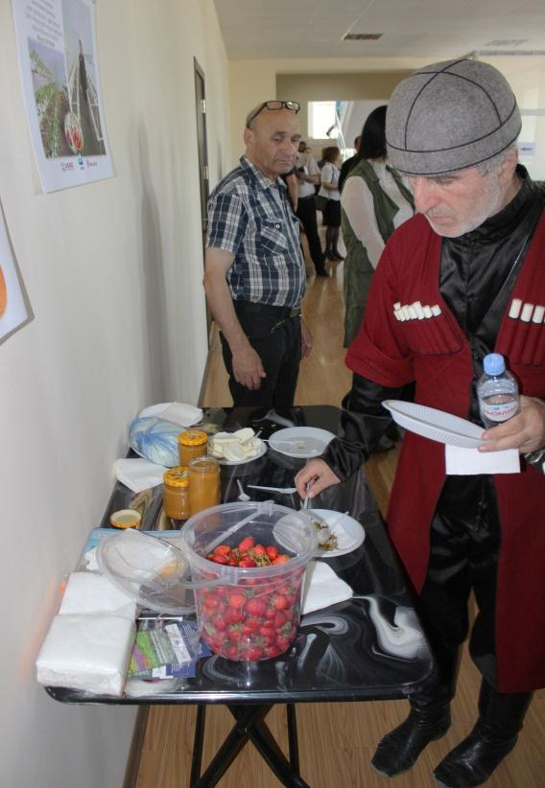
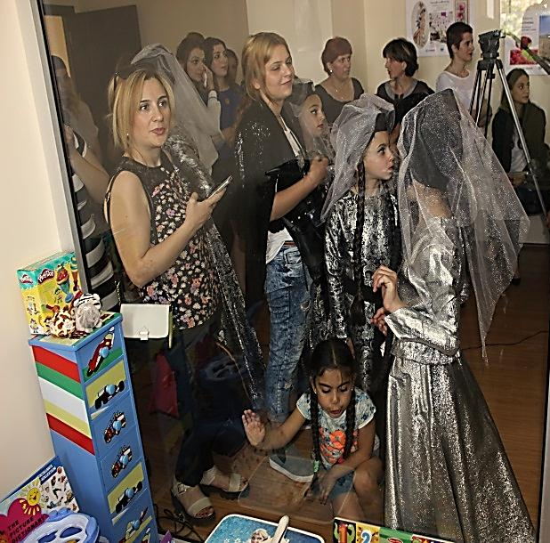
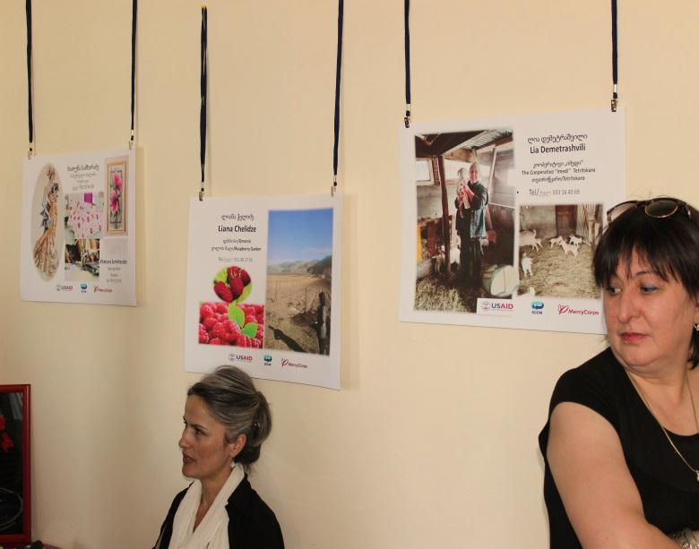
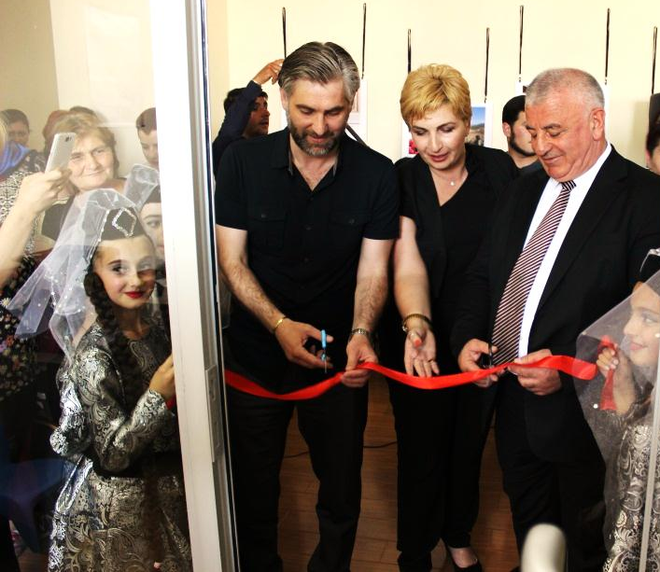
Component 1 – Women’s Rooms
Gardabani Women’s Room
On June 3, 2013 the Women’s Room was officially opened in Gardabani Municipality. The opening ceremony was arranged by the program team, Women’s Room’s Manager, cultural center of Gardabani with the Georgian national songs and dances. The opening of the Women’s Room had a big interest from the side of different stakeholders and in total counted 67 attendees.
Under the opening ceremony of the new Municipal Service of Gardabani “Women’s Room” was organized:
A workshop with participation of the authorities, Kvemo Kartli region. The theme of the workshop - “Women’s Inclusion and Existing Challenges in Municipalities”
At the end of the event - A fair/degustation of the goods, produced by the program beneficiaries from Kvemo Kartli.

Slide 15
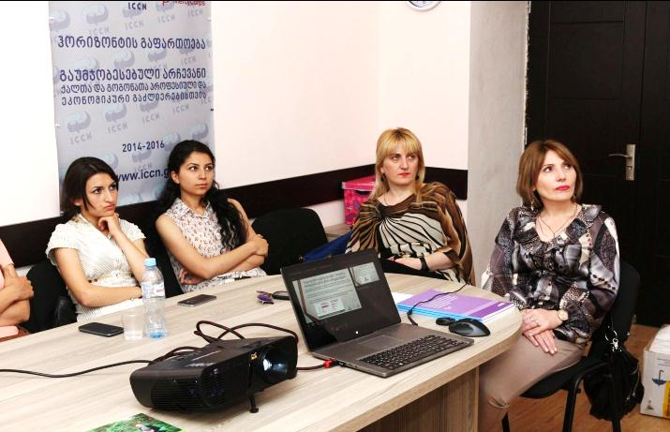
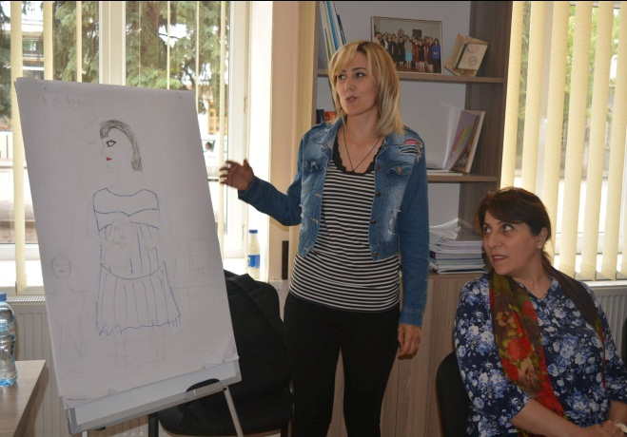
Component 1 – Women’s Rooms
Akhaltsikhe Women’s Room
In Akhaltsikhe WR the meetings were held with the representatives of Young Lawyers Association in order to conduct informational meetings and sign a Memorandum on cooperation.
The Program team started arrangements with the Wrap-up Meeting planned to be held in July in Akhaltsikhe to present the Program results and achievements to broader audience of Program Donor, Governor’s Office, Local authorities, Program beneficiaries, WR Managers, Business Grantees, various stakeholders from Program targeted municipalities.
The space and organizational support of all existing WRs is actively used by different organizations;
According to WR Coordinator -Maia Kuprava, there is a need in provision of management training to WR Managers, particularly taking a course at the “Management Academy”. Besides there are needed negotiations with the journal “Indigo” in order to deliver it to all the WRs on the monthly basis.
During the Reporting Period in total there were conducted 65 trainings. Trainings were delivered to 1624 participants; this makes 1257 persons as some of these people were trained in several subjects.

Slide 16
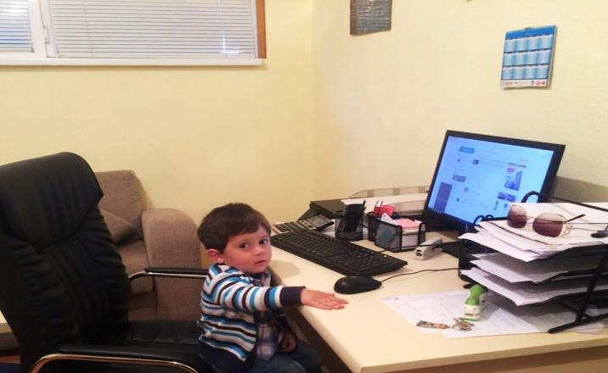
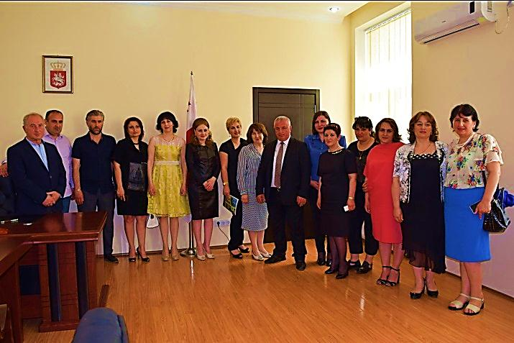
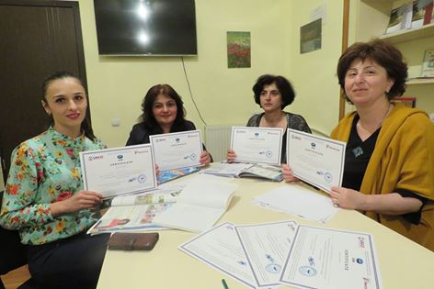
Component 1 – Women’s Rooms
Women’s Rooms in Action
The Memorandums of Understanding (MoU) on Women’s Rooms operation, signed with the Local Self-Governments were expired with the initial end of the Broadening Horizons program. As the program has been prolonged, the program team have started negotiations with the Local Self-Government representatives on extension/new memorandum signing. Therefore, at present there are signed 9 MoUs out of 13 with the following municipalities: Aspinza, Adigeni, Akhalkalaki, Borjomi, Dmanisi, Marneuli, Ninotsminda, Tetritskaro and Tsalka. The left MoUs are in the process of signing and will be available in the nearest future.
The repairing works at Akhaltsikhe Gamgeoba, where the WR is going to be operating, have already finished. The program is waiting for the starting of the whole building operation in order to open Women’s Room (There is going on a process of the whole building equipping with furniture). However, with the negotiation with the Gamgebeli of Akhaltsikhe at the Women’s Room have started English language and IT classes.
On June 3, 2013 the Women’s Room was officially opened in Gardabani Municiality. The opening ceremony was arranged by the program team, Women’s Room’s Manager, cultural center of Gardabani municipality and the Municipality Gamgeoba. The ceremony was led by the COP of the program and had other speakers including the Gamgebeli of Gardabani municipality, the Governonr of Kvemo Kartli region and the representatives of different women organizations. Besides, the ceremony was enriched with the Georgian national songs and dances. The opening of the Women’s Room had a big interest from the side of different stakeholders and in total counted 67 attendees.
Even though there is still not officially opened WR in Akhaltsikhe the WR Manager was already actively working for the program and arranging different activities and trainings. Unfortunately, implementation of the full range of WR functions will only be possible after the opening of mentioned WRs.

Slide 17
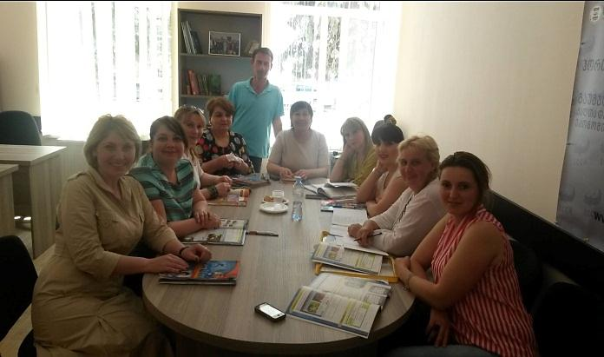
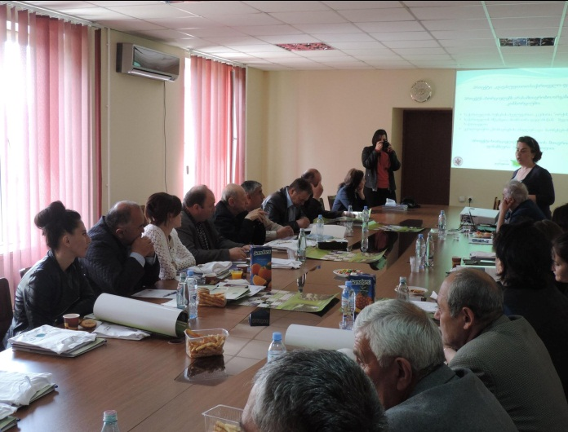
Component 1 – Women’s Rooms
Women’s Rooms in Action
As the Broadening Horizons program is close to its completion, the extensive work has been started towards the sustainability of the WRs after the program completion. Each WR developed and presented its one-year action plan to the relevant Gamgebeli and as a continuation of this process the WRs are planning future activities.
During the reporting period the information about WR services was provided to 1082 beneficiaries , through the visits of beneficiaries to WRs, WR managers’ information, WR opening and other meetings. The WR managers are continuing an active introduction of WR operation to rural population in villages and conducting relevant meetings with the representatives of different sectors in the Women’s Room. In addition, they are actively supporting the organization of various activities and meetings of other stakeholders, which are in need of WR help.
WR rooms have adopted and are using monitoring forms, which enable the program to reveal additional needs, expectations, information spreading and other. Monitoring of the mentioned information ensures better quality of program implementation.
Training on Leadership and Civic Activism
Municipality | Training | Date | Number of attendees | Number of women
Aspindza | Leadership and Civic Activism | June 15, 2016 | 14 | 14
Adigeni | Leadership and Civic Activism | June 14, 2016 | 13 | 13
Akhalkalaki | Leadership and Civic Activism | June 17, 2016 | 17 | 17
Akhaltsikhe | Leadership and Civic Activism | June 18, 2016 | 8 | 8
Ninotsminda | Leadership and Civic Activism | June 16, 2016 | 20 | 20
Tsalka | Leadership and Civic Activism | June 24, 2016 | 14 | 14
Total |  |  | 86 | 86

Slide 18
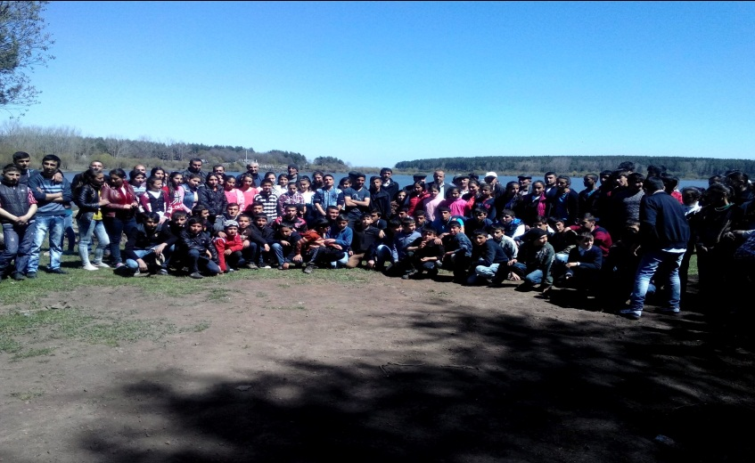
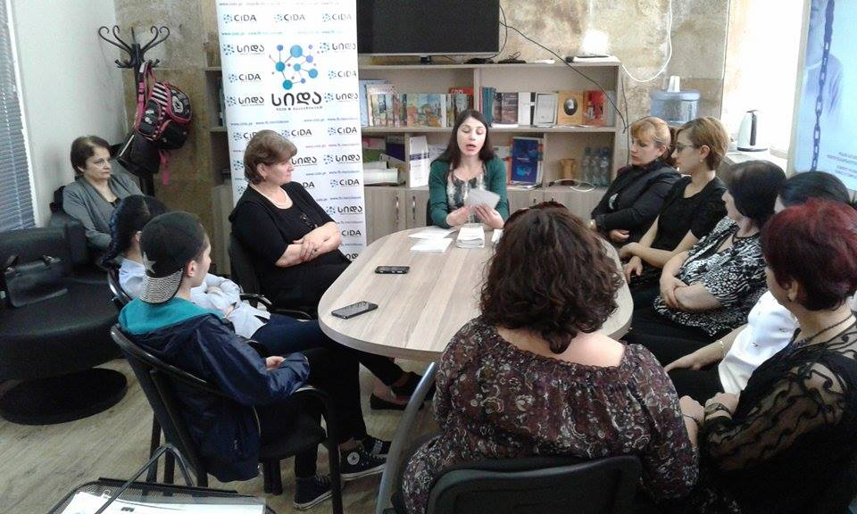
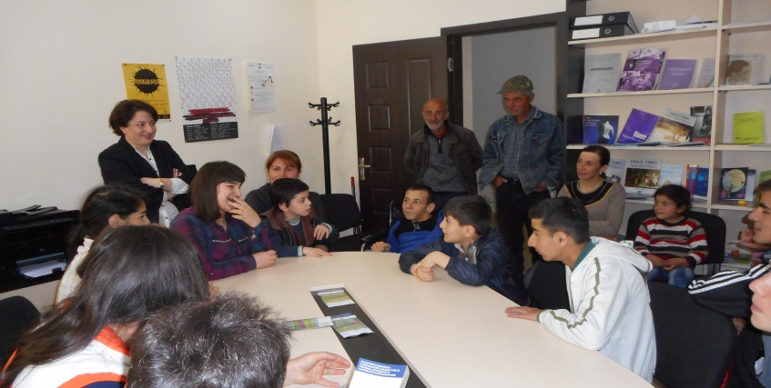
Component 2 – The Education, Career and Opportunities Fund (ECF)
As a result of Cooperation with Sandra Willet in order to better address women needs that were revealed during the implementation of the program there was developed an agricultural tourism strategy for all target municipalities of the Horizons program. The strategy is based on information from Focus Groups, meetings with different relevant organization representatives, farmers, governmental entities and desk research. The strategy was presented by Business Opportunities Coordinator of Horizons program to the program team and representatives of both target municipalities in Borjomi and Bolnisi during the previous reporting period. It was additionally presented to 17 stakeholders on April 8, 2016 in Akhaltsikhe.
All the agreements and procurement procedures for small grants for women are finished. In total there are issued 13 grants, one to each target municipality. All of the grants are already in their active implementation stage.
The Program team was actively involved in the arrangements under each grant project. Intensive communication with the grant beneficiaries through number of site visits, telephone calls, emails and meetings allowed for better understanding of their responsibilities under the Grant. Program team is always available to provide any additional support in terms of information sharing on new technologies, new training opportunities under other similar programs, new government regulations offering favorable conditions for the population living in the high mountain area (1,500 meters and more above the sea level), including additional allowances and special terms for tax exempt rules.

Slide 19
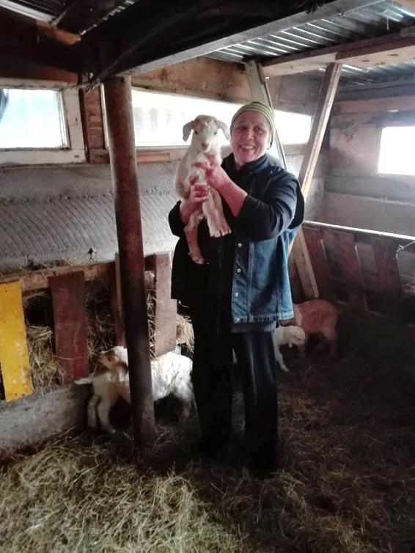
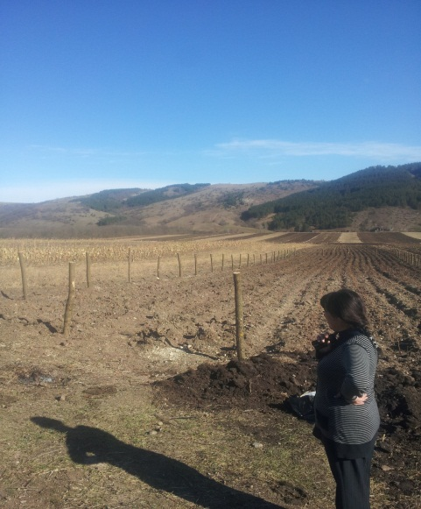
Component 2 – The Education, Career and Opportunities Fund (ECF)
The grant beneficiaries were encouraged to expand their businesses by applying for other available grants which could also help ensure the sustainability of their businesses. In addition, with support of the program team the grantees went through different trainings according to their sphere of activity. The trainings were on business plan development, financial planning, management, marketing, taxation, agricultural marketing, value chain, pricing of agricultural production, research skills, product safety, cattle breeding, human and women rights, training in monitoring of elections, English language course, HACCP, organizational management and communication, small business management, business creation and other. Almost all the beneficiaries are searching for new financial opportunities, therefore with help of the Business Opportunities Coordinator developing project proposals and applying for new grants. Several of them have already successfully gone through the first phase of selection. Besides grantees participate in the fairs, workshops and even are invited to different TV Programs: https://9arkhi.wordpress.com/%E1%83%93%E1%83%98%E1%83%90%E1%83%9A%E1%83%9D%E1%83%92%E1%83%98/
The Business Opportunities Coordinator is constantly providing grantees with information on possible funding/donors, areas and organizations for cooperation, information on their businesses and their business improvement opportunities.
The business grants have created new job opportunities. As a result, there were in total employed 22 persons (8 seasonally and 3 for one-time employment) and 18 persons are going through the internship programs.
In the frame of the grant component aimed at support of rural women it was decided to transfer these grants into the English and Computer lessons. The ECF Fund Manager together with Business Opportunities Coordinator have selected English and Computer teachers for all the municipalities. During the reporting period the English course was complete in Dmanisi Municipality and counted 12 participants. Certificates on completion of the courses were already awarded to students from Marneuli, Borjomi, Rustavi, Tetritskaro, Bolnisi, Dmanisi, Tsalka. Recently the courses in English and IT in Akhaltsikhe and Gardabani Municipalities were completed.
At present we are still in the process of collecting reports of the courses and the evaluation of the courses and their results will be possible after the completion of the all courses and receipt of the reports from teachers. The conduction of these courses is considered as small grants.

Slide 20
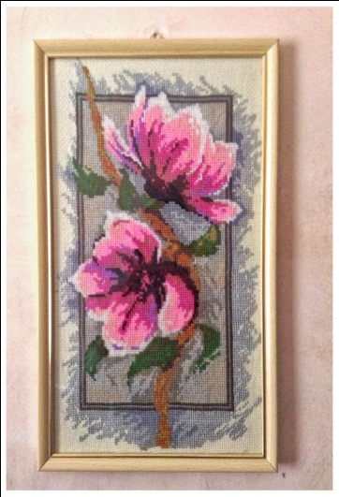
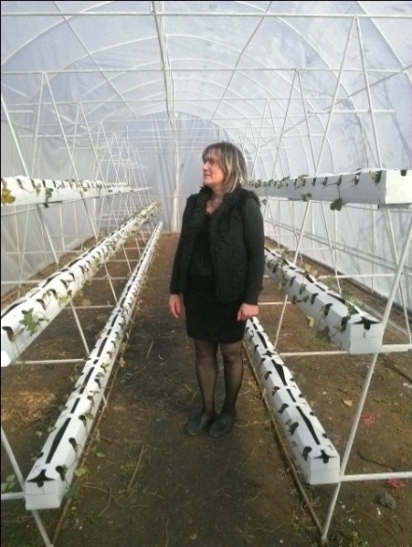
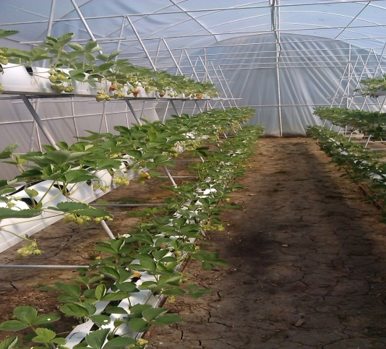
Component 2 – Career and Opportunities Fund (ECF)

Slide 21
Component 3 -Education and Schools Component
In order to raise awareness of youth on higher education and career opportunities, majors there were conducted informational meetings in Kvemo Kartli and Samtskhe-Javakheti regions. In total During the reporting period there was provided information to 739 youth, among them 373 girls.
Municipality | Date | Number of attendees | Number of female attendees
Provision of information about educational professional opportunities
Ninotsminda | April 22-26, 2016 | 52 | 27
Ninotsminda, Village Satkha | April 22-26, 2016 | 46 | 23
Ninotsminda, Public Shool 44 | April 22-26, 2016 | 24 | 18
Gardabani, village Karajala | April 25-28, 2016 | 91 | 42
Aspindza, village Rustavi | April 26, 2016 | 49 | 27
Akhaltsikhe, village Skhvilisi | May 9-10, 2016 | 37 | 13
Bolnisi, Village Kazreti | May 17-23, 2016 | 100 | 54
Bolnisi | May 17-23, 2016 | 60 | 31
Tsalka | May 20-27, 2016 | 50 | 28
Akhalkalaki | May 20-27, 2016 | 50 | 22
Tetritskaro, village Koda | May 24-30, 2016 | 50 | 33
Village Khevasheni | May 10, 2016 | 18 | 3
Village Arali | May 9-11, 2016 | 22 | 9
Village Arali | May 9-11, 2016 | 28 | 13
Village Damala | April 27, 2016 | 62 | 30
 | TOTAL | 739 | 373

Slide 22
Program Monitoring according to 7 months Work plan and the M&E indicators
Targets’ Matrix
 | Indicator | Target by the program | Current 15 June, 2016 | Current for the whole program | To be achieved by the whole program
1 | Unified Conference with participation of all counterparts organized | 1 | 0 | 0 | 1
2 | Women’s Rooms staff trained | 26 | 18 | 18 | 8
3 | Groups of volunteers created per municipality | 13 | 13 | 13 | 0
4 | Gender surveys/ researches conducted per municipality | 13 | 0 | 0 | 13
5 | Database of 1000 local women created covering all 13 municipalities | 1 | 0 | 0 | 1
6 | Women focal points trained/ mentored | 39 | - | - | -
7 | Training on leadership provided to 260 local women leaders | 13 | 6 | 6 | 7
8 | Network of 39 trained local focal point-women created/strengthened | 1 | 0 | 0 | 1
9 | Village reps. trained and mentored on gender related issues | 300 | 78 | 246 | 54
10 | Women present at community meetings | 20% | 24% | 22.81% | 20-%
11 | Percentage of HH’s supporting daughters to complete secondary education | 10% | 10% | 96.37% | 10%
12 | Second and third Parts of the Documentary produced | 1 | 0 | 0 | 1
13 | Monitoring of ECF grants’ implementation | 104 | 48 | 48 | 56
14 | Study visits of local girls to educational institutions | 3 | 4 | 4 | 0
15 | Information packages prepared and Leaflets printed/ distributed | 3500 | 739 | 1500 | 1261
16 | Practical workshops/ expert consultancy delivered to Rural women | 39 | 13 | 14 | 12
17 | High school students benefit from internship/on the job training | 26 | 105 | 105 | 0
18 | Meeting/Training on how to build employment or income generation skills | 260 | 0 | 0 | 260
19 | Women’s Rooms providing language courses | 13 | 13 | 13 | 0
20 | Women’s Rooms opened | 13 | 12 | 12 | 1

