Slide 1

Historical Archive of Georgia in Conflict Resolution and Peace Building
International Center on Conflict and Negotiation (ICCN)
Mariam Kalandarishvili MA in Political Science,
Programme Officer

Slide 2

Historical Archive of Georgia in Conflict Resolution and Peace Building
Since its foundation (August 8, 1994) the International Center on Conflict and Negotiation (ICCN) has been operating in the field of conflict resolution and peace building in Georgia and Caucasus.
Over the past 25 years a unique database of materials has been collected in ICCN’s archive, displaying the history of 1990s Georgia on its way toward resolving armed conflicts, in terms of the viewpoint of the Civil Society participation.
In 2014 our Center decided to publish remarkable archival documents at our disposal on our web-site, thus making available the historical archive of Georgia.

Slide 3
Our goals
This Archive will enable access to researchers that are working on peace process related provisions.
Support scholars and interested individuals engaged in peace processes.
Give access to comparative statistical information on how peace agreements deal with core issues of inclusive participation, third neutral parties and their roles, cease fire and security issues and broader issues of transitional justice.

Slide 4
ICCN’s Archive Components
Concepts and Initiatives for Conflict Resolution in Georgia;
Peace Agreements’ Collection;
History of Creation of National Security Concept of Georgia (collection of documents);
08.08.08 Documents;
1917-1921 Documents.

Slide 5
Concepts and Initiatives for Conflict Resolution in Georgia
Among the collection there are concepts and initiatives identified and elaborated by the Civil Society of Georgia submitted to the interested institutions and the Government to discuss and implement all possible steps towards the conflict settlement and resolution.

Slide 6
Statistics
number of
year
documents
1992
2
1993
2
1995
1
1996
3
1997
2
1998
3
1999
6
2000
3
2001
2
2002
4
2003
1
2004
4
2005
7
2006
2
2007
3
2008
2
2010
2
2011
5
2014
1
2015
1
2017
2
2018
3

Slide 7
Peace Agreements’ Collection
From 2014 the organization allocated, identified and coded dozens all hard copies and e-versions of documents related to peace process and conflict settlement.
The full GEO PeaceDatabase will give access to a definitive collection of 1991 -2018 Peace Agreements, which at present comprise about 500 PAs between Georgian-Abkhazian, Georgian-S.Ossetian, Georgian-Russian sides and International Stakeholders involved as a Third Neutral Parties.

Slide 8
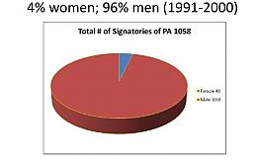
Apart from its own collection of PAs ICCN has already reviewed, categorized, collected, and digitalized many additional PAs from several sources to make its existing documentary base fully comprehensive and integral.
Peace Agreements are already coded using several variables. This is an example of one of the variables: Out of 1058 signatories only 4% were women.

Slide 9
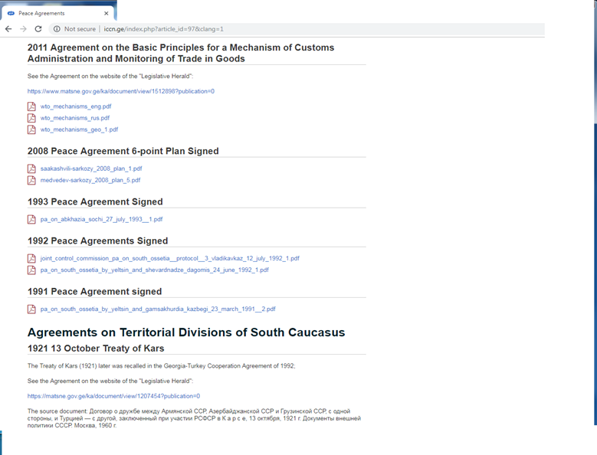
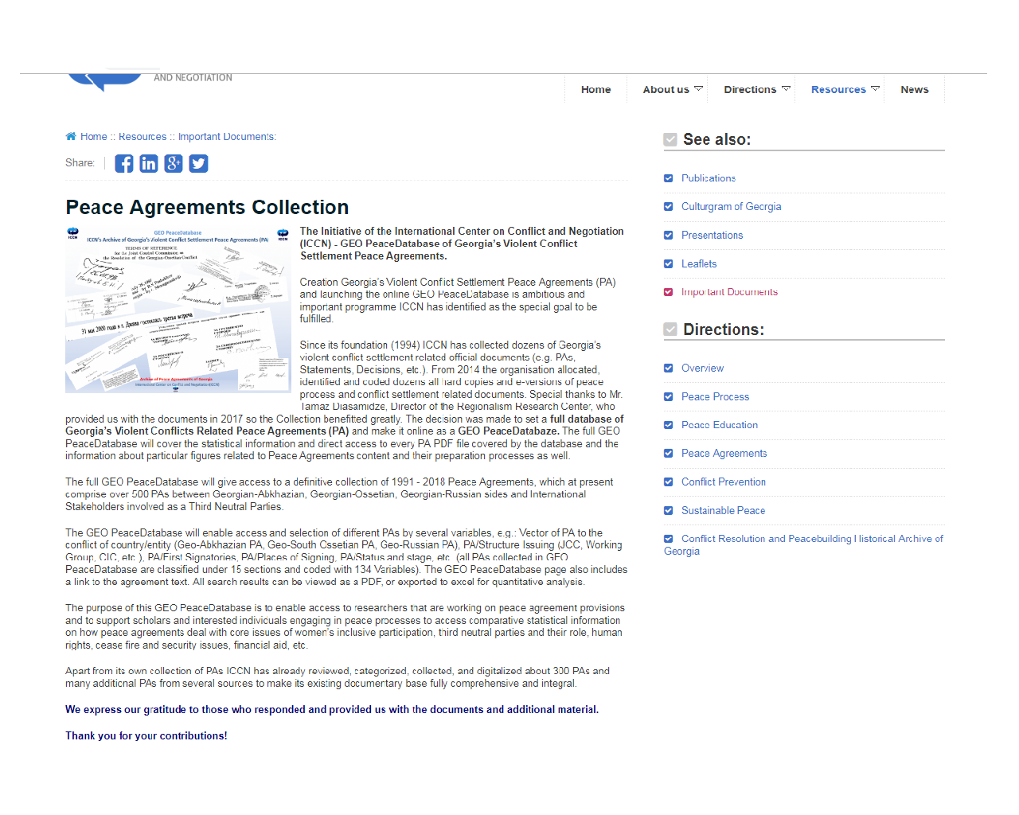
Peace Agreements on the ICCN.ge

Slide 10
For the History of Creation of National Security Concept of Georgia
Like any new sovereign state, Georgia passed through political and economic transformation and the process of developing a new approach to its state interests and national security priorities.
Development of scientifically substantiated and comprehensive national security concept is vitally important in forming internal and foreign policies.

Slide 11

year | number of documents
1996 | 2
1997 | 2
1998 | 1
2000 | 1
2005 | 2
2007 | 1
2011 | 1

Slide 12
08.08.08 Documents
It is vital and obligatory for the State of Georgia to provide the 2008 war-affected society with information on the tragic military-political events.
Among the documents that we have collected are the Stenographic Transcripts of the Sessions of the Temporary Investigation Commission of the Parliament of Georgia studying military aggression and other actions committed in 2008 by the Russian Federation against the territorial integrity of Georgia.
We believe this would be very interesting for the researches of this conflict.

Slide 13
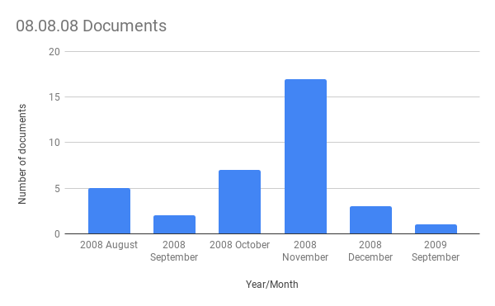
Statistics on 08.08.08 Documents

Slide 14
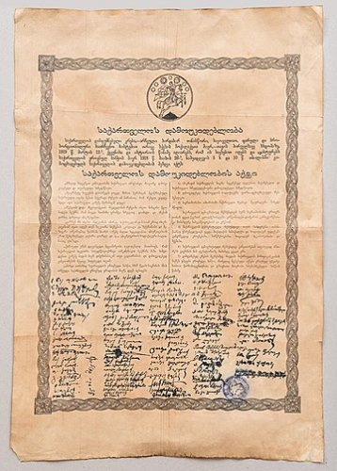
1917-1921 Documents
As well as collecting contemporary documents that give us understanding of the conflict ICCN has published historical documents from the 1917-1921 years which have seen the collapse of Russian Empire and establishment of short lived democratic regimes in the South Caucasus;
thus we want to provide users with historical context of the state building processes in the region.

Slide 15
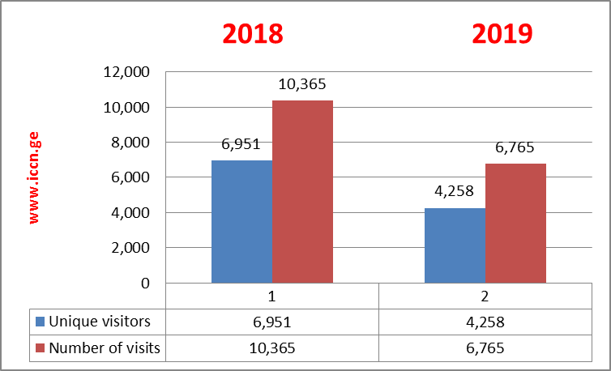
ICCN.ge - WebStatistics

Slide 16

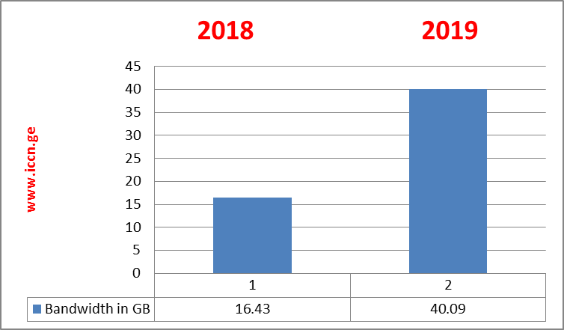
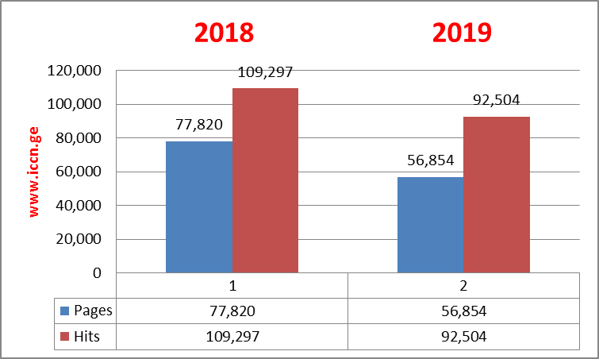

Slide 17
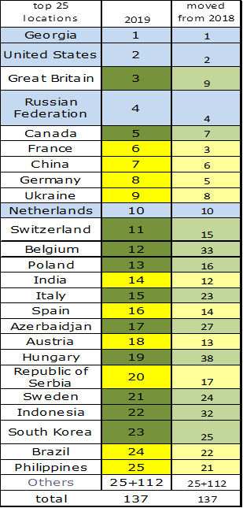
Visitors by country
All in all our website has been used by people from 137 countries.
we are also excepting increase of visitors as there is a positive dynamics in the first 6 month of the year.

Slide 18
Issues
Lack of partnership with relevant stakeholders to regularly enlarge the archive;
Limited number of specialized staff (both paid and volunteers);
Lack of interest from the donors to provide sustainable funds. ICCN has been developing the Archive on its own since 2014;
Lack of professional cooperation and communication with already developed archives

Slide 19
Thank you very much
We welcome you to our website www.iccn.ge

