Slide 1



Workshop
Yerevan, June 3, 2021
Conflict Assessment Framework

Slide 2
GPPAC Mission
GPPAC mission is to achieve a global shift in peacebuilding - from solely reacting to violent conflict to preventing conflict.
To do this, we work for collaboration between different groups – civil society, academia, media and decision makers.

Slide 3
Food for Thought
Which factors contribute to the confrontation and division between the people living on both sides of the dividing lines in the conflict zones?
Which factors contribute to the reconnection, conciliation, mutual understanding and cooperation between the conflict-separated people?
Which types of the programs/project could contribute to confidence-building and conciliation and vice versa
What changes would you make in your organization to contribute to the prevention and/or de-escalation of conflict(s)

Slide 4
6 CONFLICT-RELATED QUESTIONS
1. Where and in what environment the conflict happens?
2. Who are the stakeholders?
3. Why stakeholders act in this or other way?
4. Which factors trigger, fuel and/or defuse the conflict?
5. In which forms the conflict manifests itself?
6. When and in which period the conflict has happened?

Slide 5


6 PRISMS OF VIEWING CONFLICT
Context
Parties
Motivation
factors
power
Chronology
01
02
03
04
05
06
Institutions, Positions, Actions Interests
Influence, Interests, Legitimacy, Capabilities
Needs, Grievance Dignity, Identity Desire to grab
Violence, Political, Economic etc.
Root Causes
Physical, Political, Economic, Moral Military etc.
History of the Conflict
Phases of Conflict

Slide 6
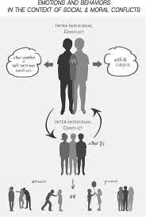
Context of the Conflict
Social, political, economic, emotional environment where conflict occurs
Who initiates and/or fuels the conflict? Who are dividers?
Who tries to prevent and/or defuse the conflict? Who are connectors?
What are their attitudes and actions?

Slide 7
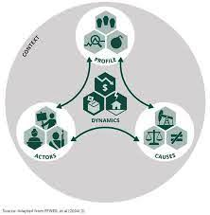
Context of the Conflict
How justly systems and institutions operate and do they meet citizens’ needs
Conflict vs. coincidence of values and interests
Do the parties have any successful joint experience or joint venture?
Symbols/events serving as sources or triggers of conflict

Slide 8
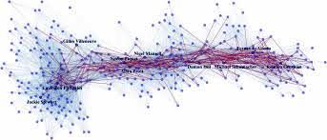
Roots, Sources, Causes of Conflict
Diversity of Factors
Institutional and Structural Factors
Social/Economic Inequality
Significant environmental hazard
Uncontrolled arms trafficking/supply
Disputable monuments and symbols
Cultural, ethnic and religious factors

Slide 9

Stakeholders
Influence/Impact
Potential/Capabilities
Informed/Disinformed
Legitimacy

Slide 10

Motivations of Conflict- Who, What?
Motivators
Unmet Demands
Unmet Interests
Intransigent Positions
Satisfaction/Dissatisfaction

Slide 11

Power/Influence and Conflict
Different Sources of Power
Military Power
Personal Power
Economic Power
Informational Influence
Religious Influence
Influence by Social Capital
Influence by Relationships
Moral Power
Imbalanced Power

Slide 12


Period of Conflict
Chronology of Conflict
When did the conflict start?
In which intensity the conflict persisted?
How stakeholders perceive history of the conflict?
Periods causing a “trauma”
Emotional impact of the past
Influence of specific periods

Slide 13
Pattern of Conflict Analysis
Oriented on the target audience
Descriptive, not judging and impartial
Contain recommendations for early actions
Using plain language and be reader-friendly
Using combination of graphics and texts
Avoid information overload, well-structured key messages

Slide 14
Levels of Potential Changes
FACTORS AT DIFFERENT LEVELS | CHAHGES NEEDED | POTENTIAL APPROACHES
Individual/Personal Factors (attitudes, behaviors, perceptions, skills etc.)
Individual Relationships (patterns of individual interaction across group lines etc.)
Group Relations & Social Norms (how different groups relate to each other)
Institutions (formal & informal) (How they function and how do they influence conflict)
Deep Social, Political and Economic Structures and Culture (do they aggravate or reduce conflict)

Slide 15
Thank You For Attention
Live in Peace

